Slide 1

DX University
Bryce Canyon, UT – 2012

Slide 2
Building a Dxing Station
– Equipment –
Mark Richardson W7HPW

Slide 3
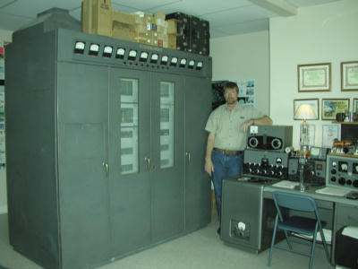
Mark Richardson W7HPW
Licensed in Novice/Technician 1985 as KB7DAL, General/Advanced 1996, Extra 1997
Awards: DXCC, 5BDXCC + 17&12, Phone, CW, Digital – Current 318 confirmed, DXCC Millennium
Professional Network Engineer with Mountain States Networking
Club Memberships: UDXA, ARRL

Slide 4
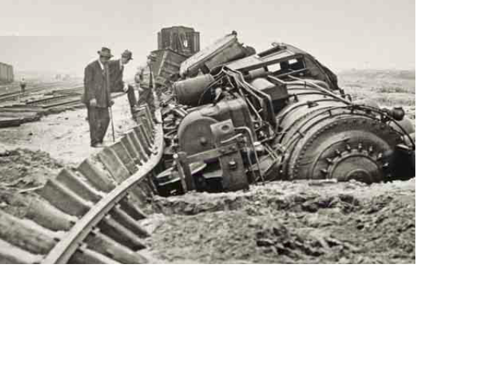
Station Considerations
Transceivers
Antennas
Automation

Slide 5
Choosing a Transceiver for DX
High close-in dynamic range (copy S1 in crowded band)
Low noise floor (copy very weak signals)
Low phase noise (low noise on the Local Oscillator)
Low in-band spurious on both receive and transmit
Low IMD on SSB transmit, and low key clicks on CW transmit
Effective SSB speech processor (more talk power)
Good receive and transmit audio quality (intelligibility)
Smooth AGC for low fatigue (noise doesn’t fill in spaces)
AGC that doesn’t exaggerate impulse noise (hangs up AGC)
Good ergonomics of controls and menus (easy adjustments)
Good display that also shows important settings

Slide 6
Dynamic Range
The range in dB of very strong signals to very weak signals that the receiver can handle At The Same Time
What is Close-in Dynamic Range vs.
Wide-Spaced Dynamic Range?
Why is Close-in Dynamic so important for CW ops?
Why is it less important for SSB operators?

Slide 7
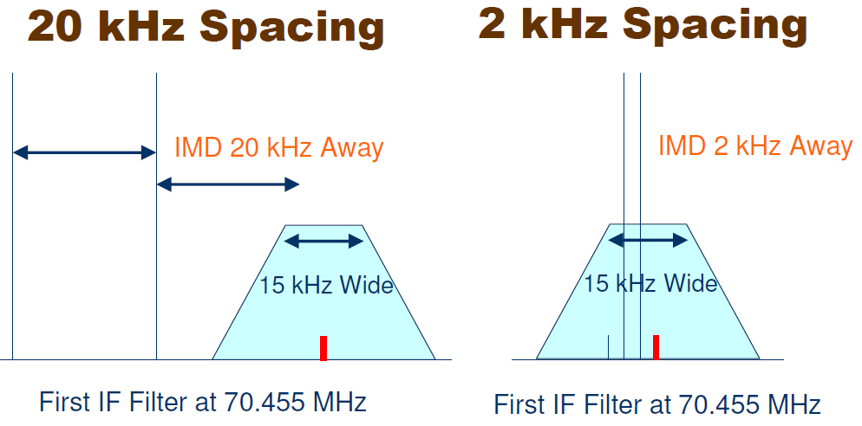
Dynamic Range
Wide & Close Dynamic Range

Slide 8
Dynamic Range
If you know the close-in dynamic range of a radio, at what signal level will IMD start to be a problem?
S Meter standard is S9 = 50 μV, which is –73 dBm
Assume a typical radio:
500 Hz CW filter Noise Floor of -128 dBm Preamp OFF
Dynamic Range Signal Level Causing IMD = Noise Floor
55 dB S9 FT-757
60 dB S9 + 5 dB FT-101E
65 dB S9 + 10 dB KWM-380
70 dB S9 + 15 dB TS-830
75 dB S9 + 20 dB 756 Pro II / III
80 dB S9 + 25 dB Omni-VII
85 dB S9 + 30 dB R9500
90 dB S9 + 35 dB Orion I (93 dB)
95 dB S9 + 40 dB Orion II & Flex 5000A
100 dB S9 + 45 dB K3, FTdx5000

Slide 9
Dynamic Range
The dynamic range of a radio is the same with an attenuator ON or OFF.
If on a noisy band, attenuate the noise and all signals to make better use of the dynamic range, and reduce the chance of overload.
If band noise goes from S6 to S2 by turning on the attenuator, you have lost nothing, yet your radio is being stressed much less.

Slide 10
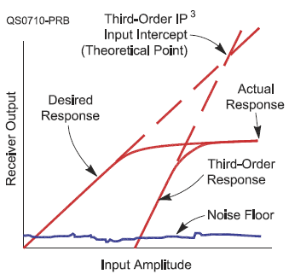
IP3 (3rd Order Intercept)
It is a theoretical number.
It has more meaning for a block amplifier or mixer.
Almost meaningless if the AGC of a receiver is involved
  October 2007 QST Product Review FT-2000D
  DR3 Spacing Level IP3
  98 dB 20 kHz Noise Floor +25 dBm
  69 dB 2 kHz Noise Floor -19 dBm
  29 dB 2 kHz 0 dBm = S9+73 dB +15 dBm

Slide 11
Blocking & Phase Noise
Blocking is the onset of gain compression.
This can be an issue with another ham within “line-of-site”.
It is an issue on Field Day and multi-multi contest stations.
Low phase noise is desirable, but a very good low phase noise receiver has to contend with transmitted phase noise.
Dealing with transmitted phase noise is like dealing with transmitted IMD products and splatter. We cannot do much about it.

Slide 12
Noise Floor?
Sensitivity is a familiar number, normally applies to SSB.
Sensitivity = 10 dB Signal + Noise / Noise (10 dB S+N/N)
Noise Floor = 3 dB Signal + Noise / Noise (3 dB S+N/N)
Noise floor can be measured at any filter bandwidth, CW or SSB, for example, and is bandwidth dependent.
ARRL normally only publishes noise floor for a CW bandwidth, typically 500 Hz CW filter.

Slide 13
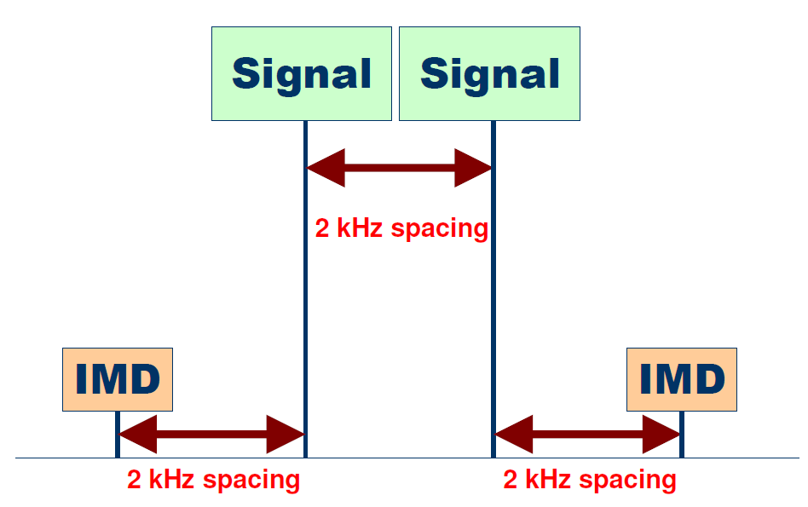
Transmitter Third Order IMD

Slide 14
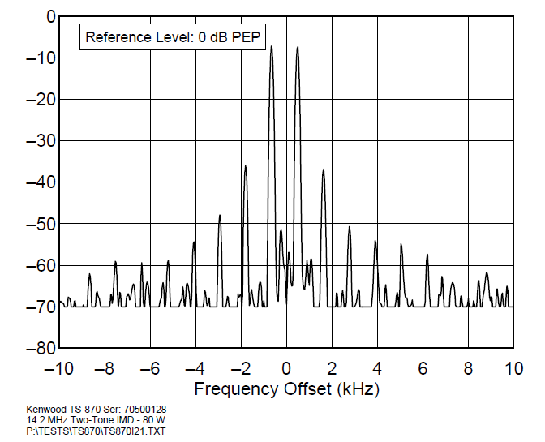
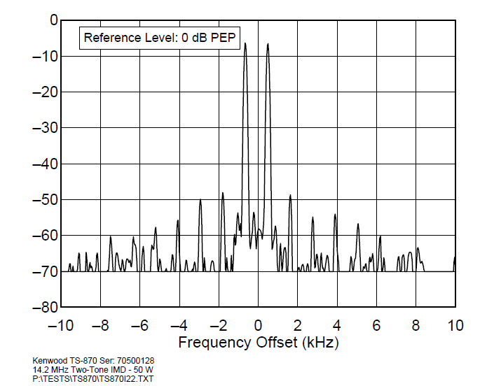
Close-in Signals and Splatter
Reduce your power
-30 dB
-42 dB

Slide 15
Close-in Signals and Splatter
Some transceivers, in addition to normal IMD products, produce additional ALC-Induced splatter. On CW the ALC can cause leading-edge key clicks.
Some modern rigs splatter more if the ALC is more than “tickled”, or induce clicks on CW.

Slide 16
Conclusions
DX’ers need a good receiver for SSB and even better for CW
High Dynamic Range Receiver
Good Speech Processor on SSB
But Your Brain Can Get “Fried” due to operator fatigue.
Bad audio can be a factor in that fatigue.

Slide 17
Station Considerations
Transceivers
Antennas
Automation

Slide 18
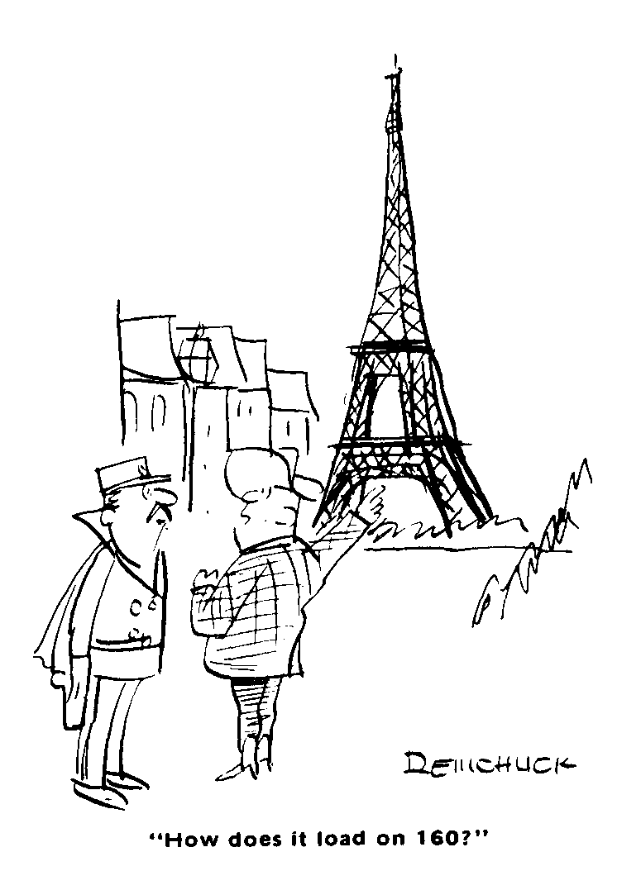
Antenna Considerations
"All I'm totally certain of is that any antenna is better than no antenna and the antenna should preferably erected as high and be as long as is possible or desirable".

Slide 19
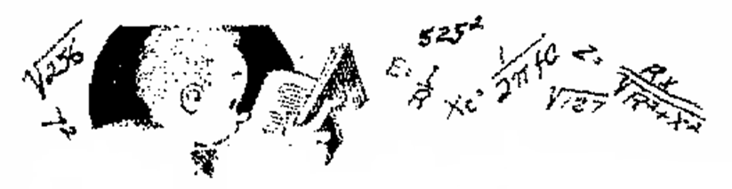
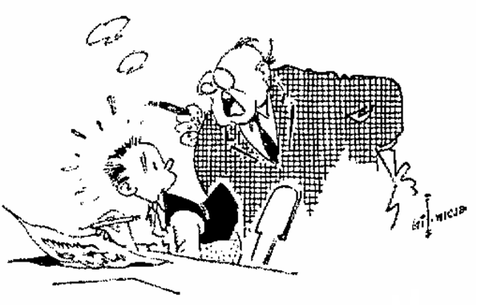
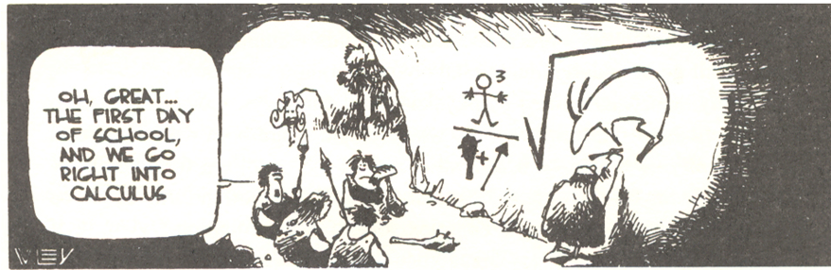
Oh, Math, Where is thy Sting?
Strong Measures are necessary to drive the
mathematical spooks from the castle of the amateur mind”

Slide 20

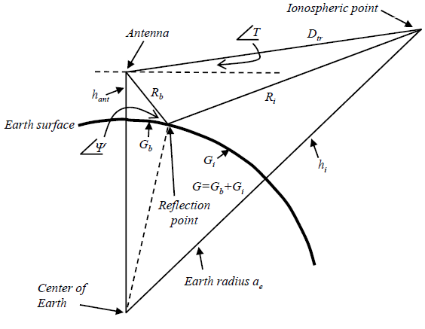
The Hard Stuff
Matching a Antenna to the propagation path
where:
hant is the height at the receiving antenna,
ae is the earth’s radius,
the distances G and Gb are functions of the angle T between the local horizon and the direction to the wave source point at height hi in the ionosphere.

Slide 21
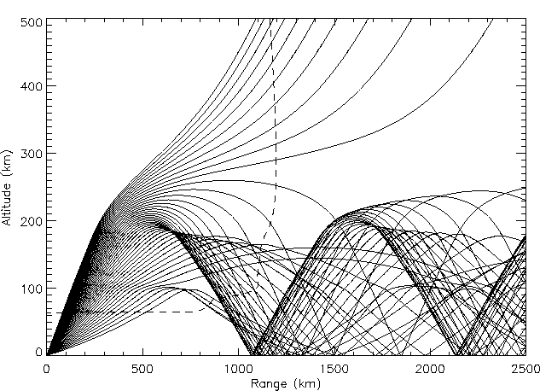
Arrival Angles

Slide 22
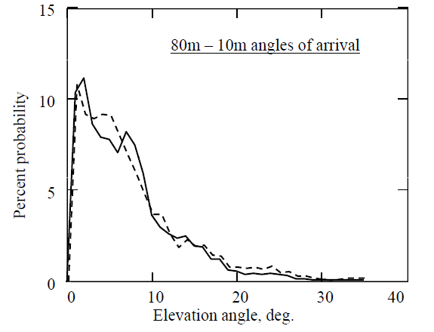
Arrival Angles

Slide 23
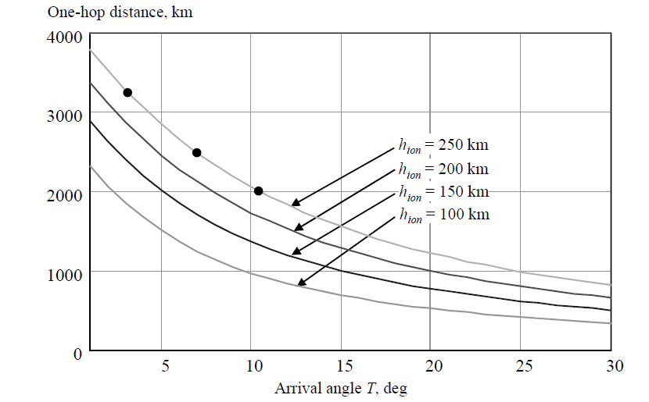
Arrival Angles vs. Distance
Hop distances, with the 3, 4, and 5 hop points marked for a 10,000 km path

Slide 24
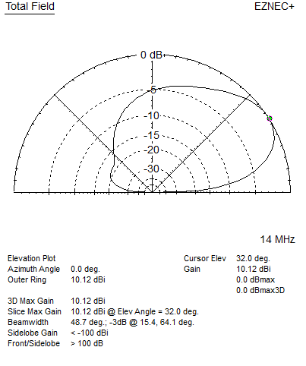
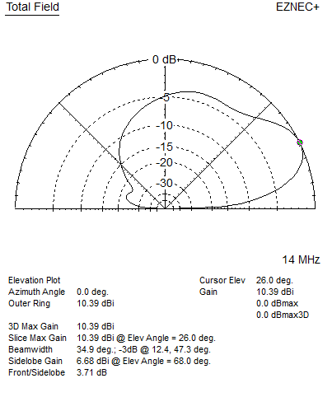
Radiation Angles
3/8ʎ 1/2ʎ

Slide 25
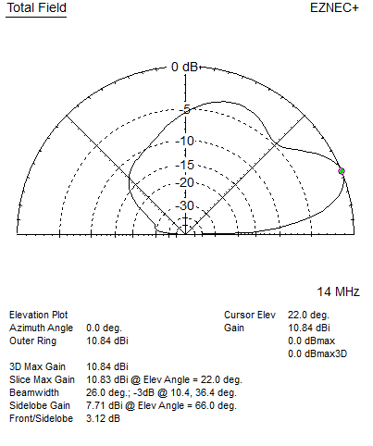
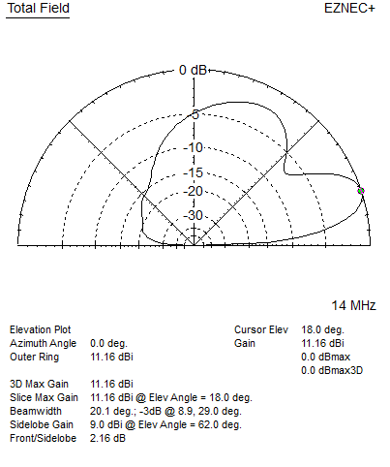
Radiation Angles
5/8ʎ 3/4ʎ

Slide 26
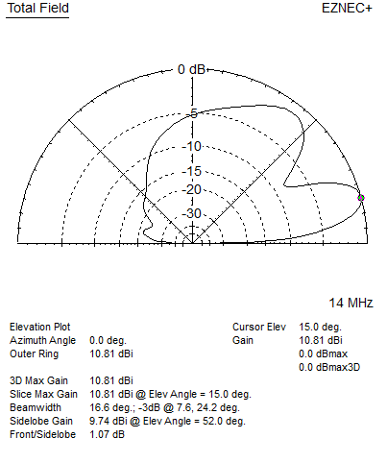

Radiation Angles
7/8ʎ 1ʎ

Slide 27
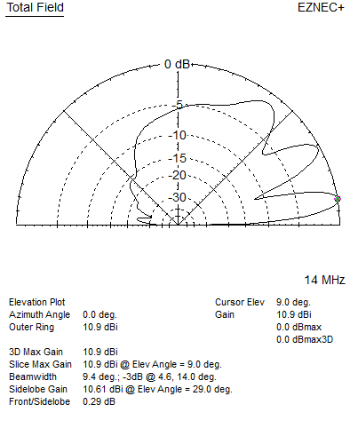
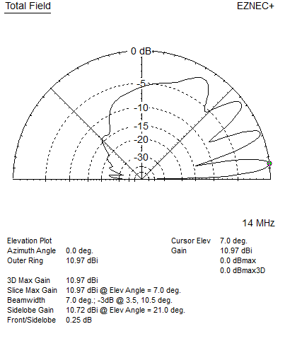
Radiation Angles
1½ʎ 2ʎ

Slide 28
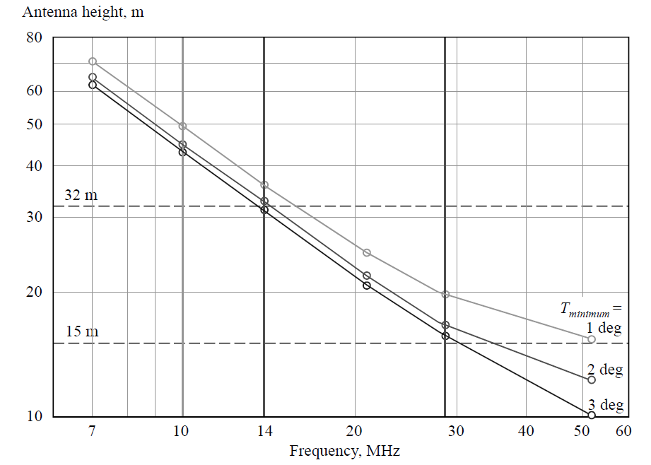
Multiband Considerations
Optimum antenna heights over even terrain for various frequencies
Notes:
One effective strategy for finding an overall optimum over multiple
bands is to choose the best height for the highest frequency band
of interest. That somewhat sacrifices the performance for the lowest
arrival angles at the lower frequency bands, but more gently than the
destructive interference loss of height gain for higher arrival angles if
a higher antenna were chosen.
The optimum heights for various frequency bands between 7 and
54 MHz are shown in here. The three curves are for three different
minimum angles, the upper curve shows optima for a 1° to 16° arrival
angle range, the middle curve for 2° to 16°, and the lower curve for
3° to 16°. The middle curve slopes from about 1.5 to 1.6 wavelengths
between 7 and 29 MHz.
If operation anywhere in the 10 m to 40 m bands is of equal
interest, the “best” height works out to about 19.9 m. That height is
suitable for arrival angles as low as 1° in the 10 m band, and is also
suitable for angles above about 4° in the 20 m band. In the 40 m and
30 m bands the results are “best effort,” but as will be shown in the
next section, paths at higher arrival angles may exist, but with an
increased number of earth-ionosphere hops. If the 20 m band is to be
optimized, then the best height is about 32 m. If 6 m band operation
is important then the optimum height is about 15.3 m. The heights
between about 15 m and 32 m (50 to 105 ft) emerge as a good range
of compromise choices for multiband HF and 6 m band operations.

Slide 29
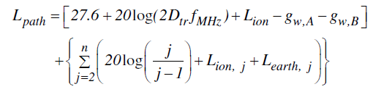
Path Loss vs. Arrival Angle
Notes:
Notice that the four-hop path has a stronger signal by over an
S-unit more than the example three-hop path because the increased
height gains gw of a combined 8 dB at the higher arrival
at both ends of the link more than compensate for
the additional reflection losses of an additional hop. The height gain
is the intersection of the arrival angle, T, with the antenna height.
The four-hop 6.9° arrival angle results in less destructive
interference by 7 dB at each end of the link than the three-hop 2.8°
arrival angle. The lowest arrival angle path is not always the best!
Agonizing over a lower “take-off angle” is futile. This effect justifies
a compromise lower limit for the angle of arrival at lower frequencies
when choosing a compromise height for a multiband antenna.
The five-hop path suffers additional earth and ionospheric reflection
losses, but still results in a respectable S = 2.9 signal.

Slide 30
Station Considerations
Transceivers
Antennas
Automation

Slide 31
Automation
Rig Control
Antenna Switching
Antenna Rotation
Amplifier Control

Slide 32
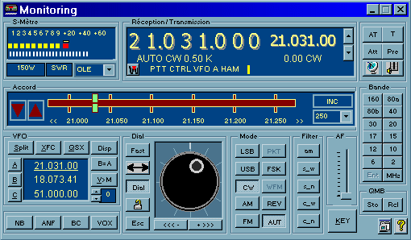
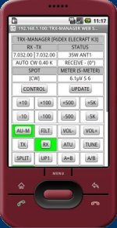
Rig Control

Slide 33
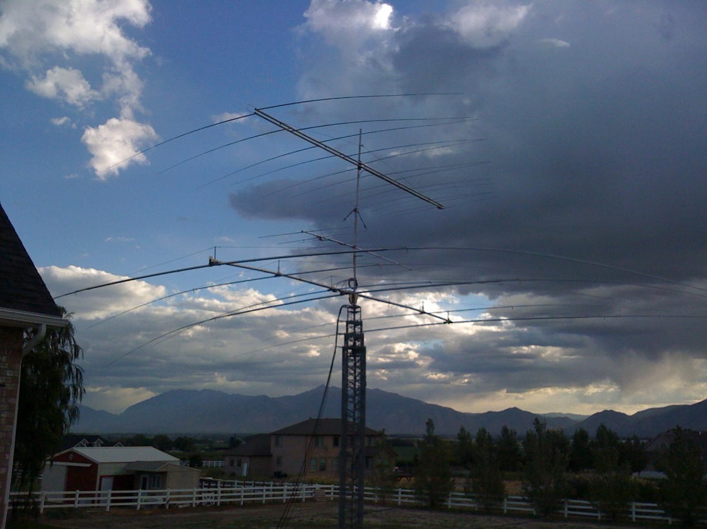
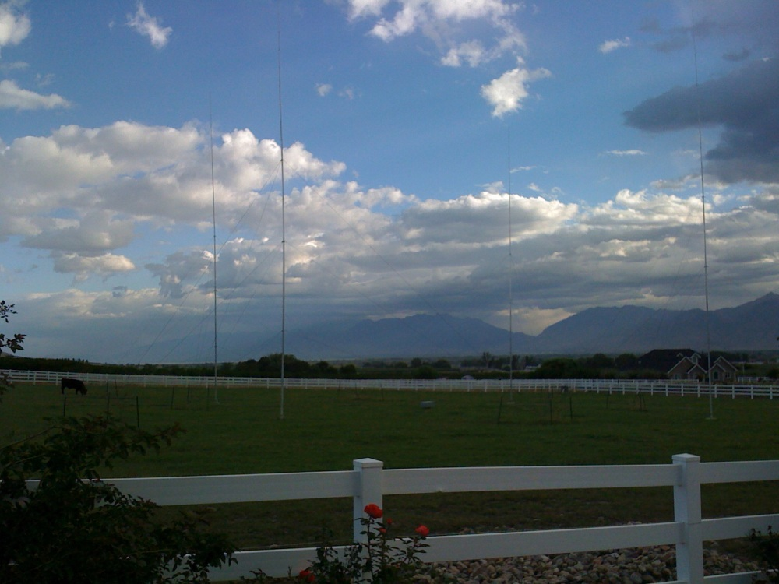
Antennas

Slide 34
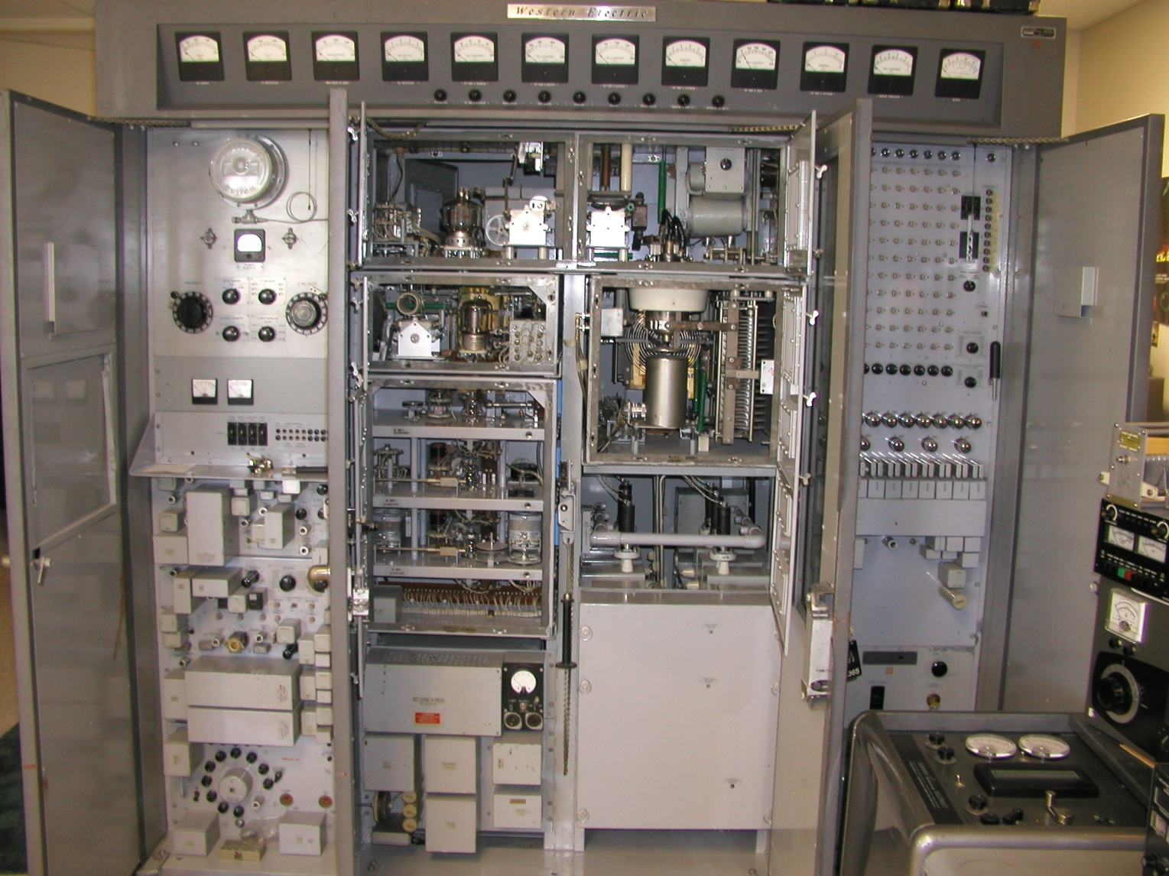
Amplifier

Slide 35
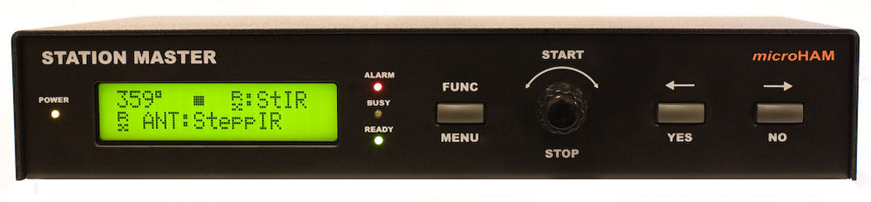
Automation

Slide 36
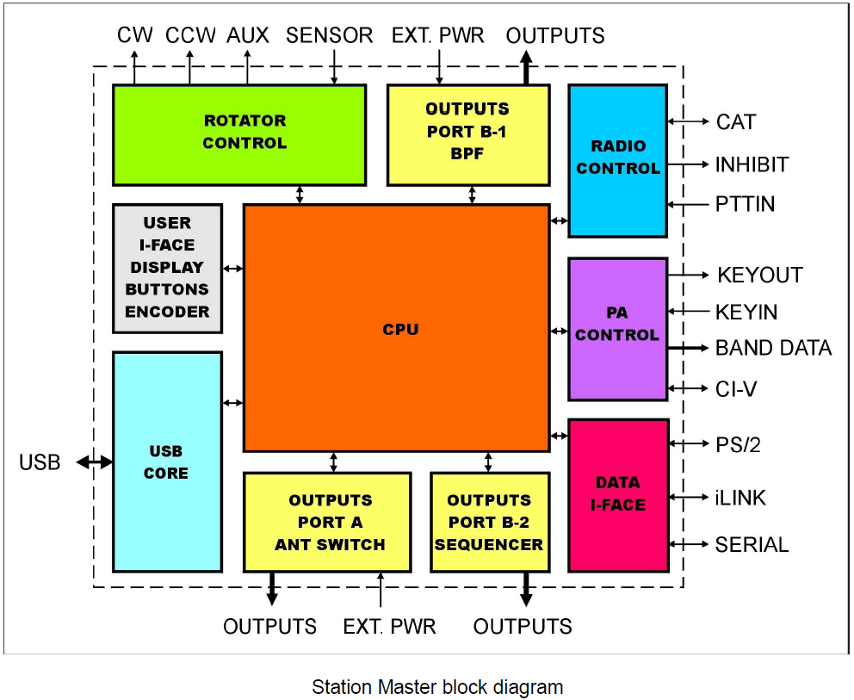
Automation

Slide 37
Automation
General:
Twenty (20) programmable relay outputs
integrated level converter (similar to CI-V, IF-232, FIF-232) for communication between computer and radio, no additional interface required
Decodes all frequencies supported by the connected transceiver, including 75m, 60m, 6m, 4m, VHF and UHF
Unlimited number of custom defined frequency segments “bands”
Single USB connection to computer
Stand alone operation
Internal Rotator control
Virtual Rotators function for automatic control of phased array systems
Separate RX/TX antenna support - including RX only antenna swtiching
Proprietary SteppIR support with automatic tuning and protection
PS/2 keypad support for manual rotator or antenna switch control
Antenna Control:
Port A:
Ten (10) programmable relay outputs
Selectable common source, common ground, external supply
External supply to +24V maximum
Compatible with all remote antenna switches using common ground or positive control
Port B:
Six (6) programmable relay outputs with selectable common source, common ground, external supply
Four (4) programmable relay outputs with isolated contacts
External supply to +24V maximum
Compatible with all remote antenna switches using common ground or positive control
Sequencer:
Any of 20 relays available for sequencer control
Independent lead/tail time for each output
Rotator control:
Three (3) programmable relay outputs
Configurable support for BRAKE or SPEED control
Support for multi-turn rotators
Support for analog (pot) or discrete (pulse) azimuth iniddcators
Programmable software limits
Four azimuth memories
Automatic azimuth control from many logging programs
Amplifier control:
Automatic tuning for CI-V controlled amplifiers (Icom PW1, SPE Expert)
Automatic band switching for BCD controlled amplifiers
Inhibit support for QSK Amplifiers

Slide 38
Amplifier and Antenna Control System

Slide 39
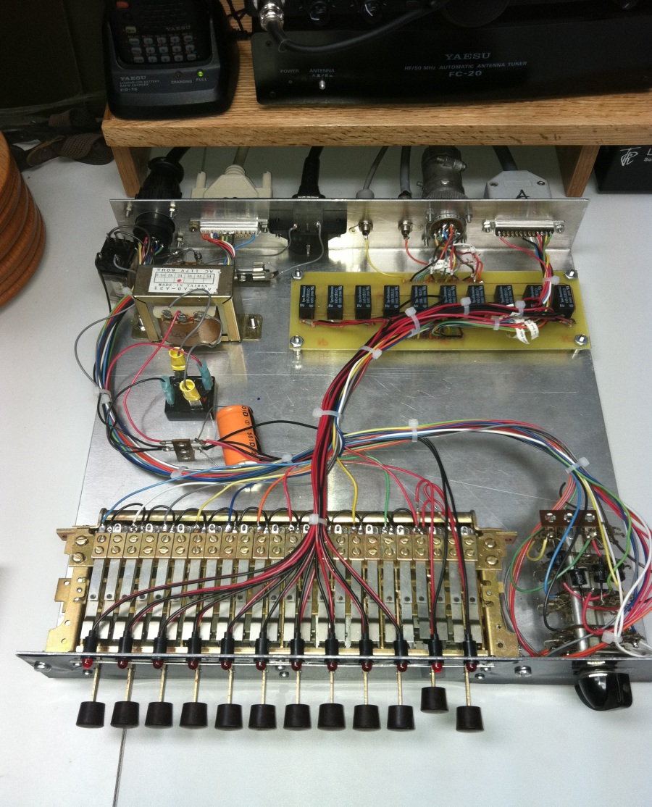
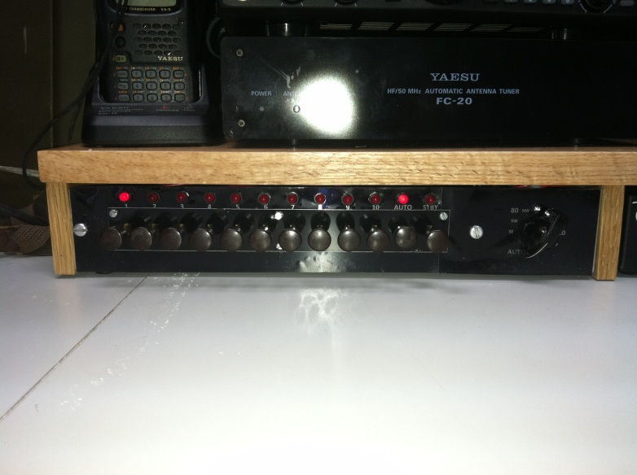
Amplifier and Antenna Control System
Manual or Automatic
Antenna or Amplifier switching

Slide 40
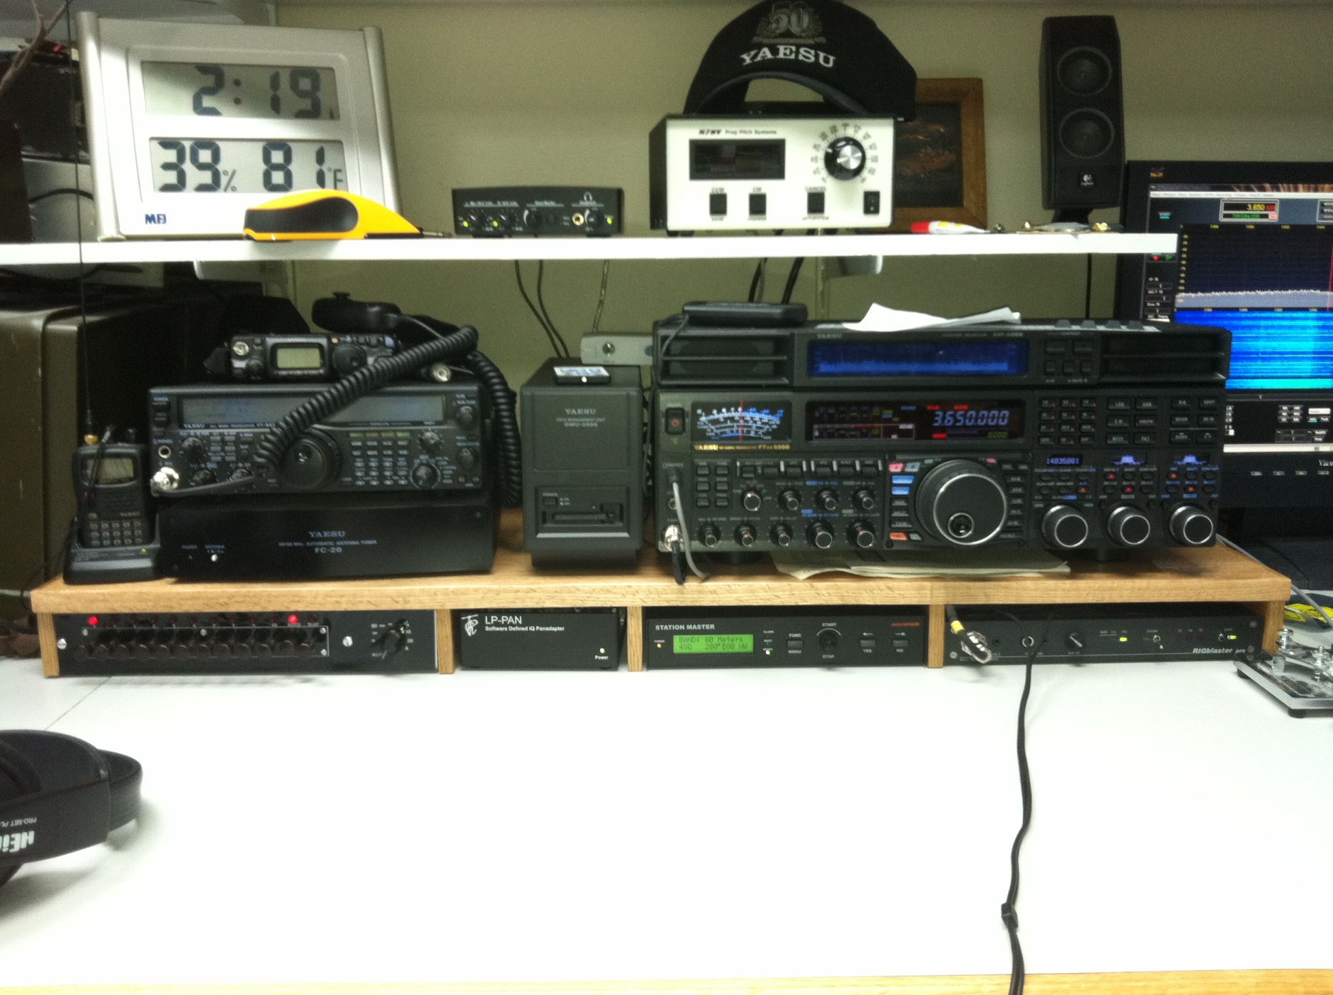
Amplifier and Antenna Control System

Slide 41
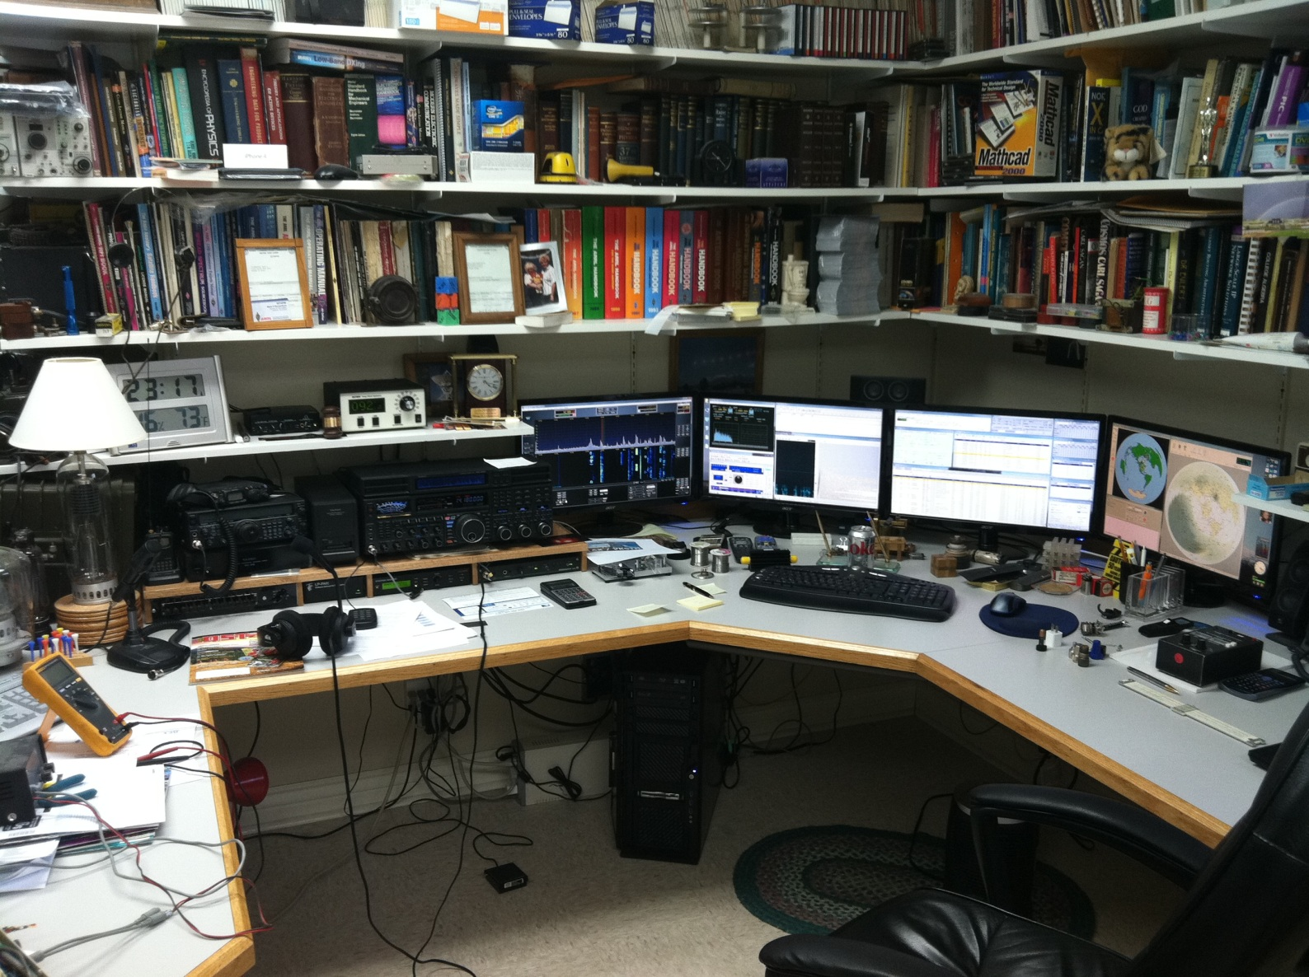
Results

