Slide 1

DX University
Hartford, CT – 2014

Slide 2
Station & Antenna Considerations
Joe Reisert W1JR

Slide 3
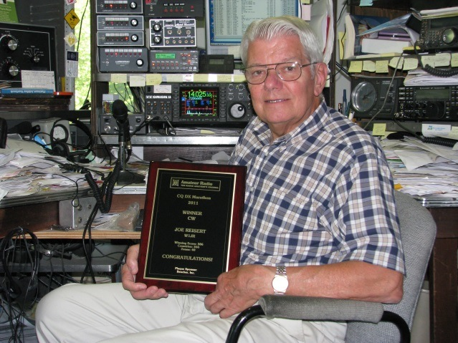
Joe Reisert W1JR
First licensed in 1951 as WN2HQL and has been a serious DXer since 1954.
Top of the DXCC Honor Roll with 391/340 total, DXCC Challenge 3148, Satellite DXCC, and 11-band DXCC (160 through 6 meters including 60 Meters).
DXpeditions in 1957 as W2HQL/KC4 (Navassa I.) and as VP2VB in 1958 with Danny Weil.
Member of the YCCC Contest Club. Life member of ARRL and AMSAT. Over 135 published articles. DX Hall of Fame (2014)

Slide 4
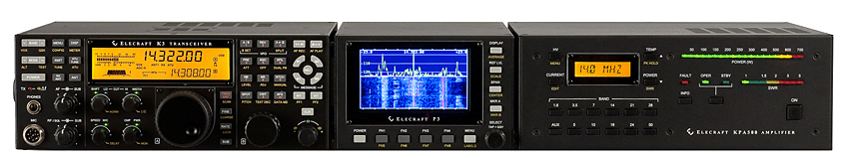
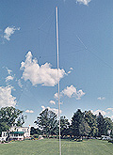

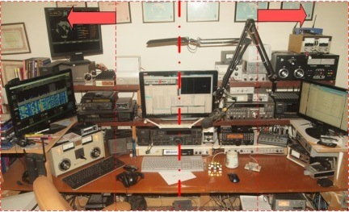
Topics
Radios
Antennas
Other Station Elements
Station Layout

Slide 5
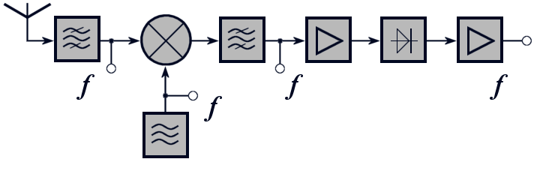
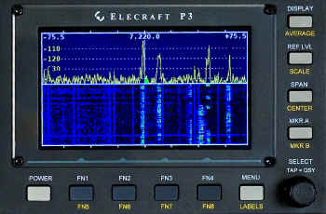
Radio Equipment - Receivers
Critical receiver requirement
  Sensitivity
  Selectivity
  Dynamic range
  Split frequency operation
Advanced capability
  Second receiver or sub-receiver
  Diversity reception. External RX ant.
  Panadapter displays
  Software Defined Radios (SDR)
~

Slide 6
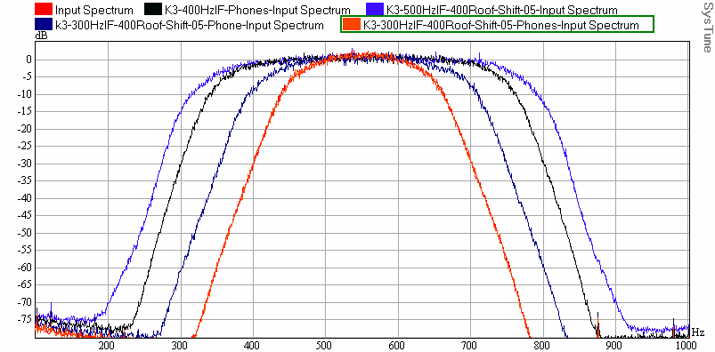
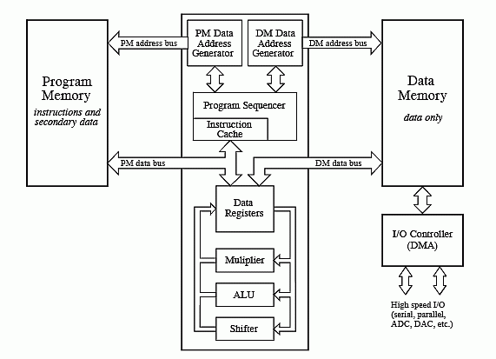
Receiver Selectivity
Roofing Filters
  Limits power applied to non-linear receiver elements
Digital Signal Processing
  Bandpass filters
  Bandpass tuning.
  Notch filters
  Noise Reduction algorithms
  Noise Blanking

Slide 7
Receiver Dynamic Range
One simple definition: Blocking Dynamic Range
    Copy a weak signal simultaneously with a high level, off-channel signal
    Ratio of signal amplitudes at point when degradation of weak signal starts
Radio | BDR, dB
Elecraft K3 | 139
Ten Tec Orion II | 136
Yaesu FTdx9000D | 127
ICOM IC-7800 | 115
ICOM IC-756PROIII | 101

Slide 8
Transmitter - Critical Requirements
Power level
  Heat is at the root of most component failures
  Consider operating radios well below maximum power levels
Output power and VSWR meter
Quality – How good (or wide) is your signal?
  Undesirable sidebands – clicks or phase noise will get you noticed
  Reduce audio distortion; audio processing may result in higher average power but can result in lower intelligibility.
  Consider covering all the operating modes
Traditional modes (CW, SSB, AM, RTTY) are native
New modes (e.g. PSK31, JT65) may require external modems

Slide 9
Antennas and Transmission Lines
General characteristics (Ref. 2)
  Antennas are the best investment in your station
  Efficient antennas are likely to be narrowband
  Reliability can be as important as performance
  Requirements related to effective DXing
Higher antennas work DX better than lower ones
  Pattern matching propagation path to DX (Ref. 1)
  Pattern reducing effects of interference
  Transmission line losses (Ref. 2)
  Baluns and chokes (Ref. 5, 7 & 8)

Slide 10
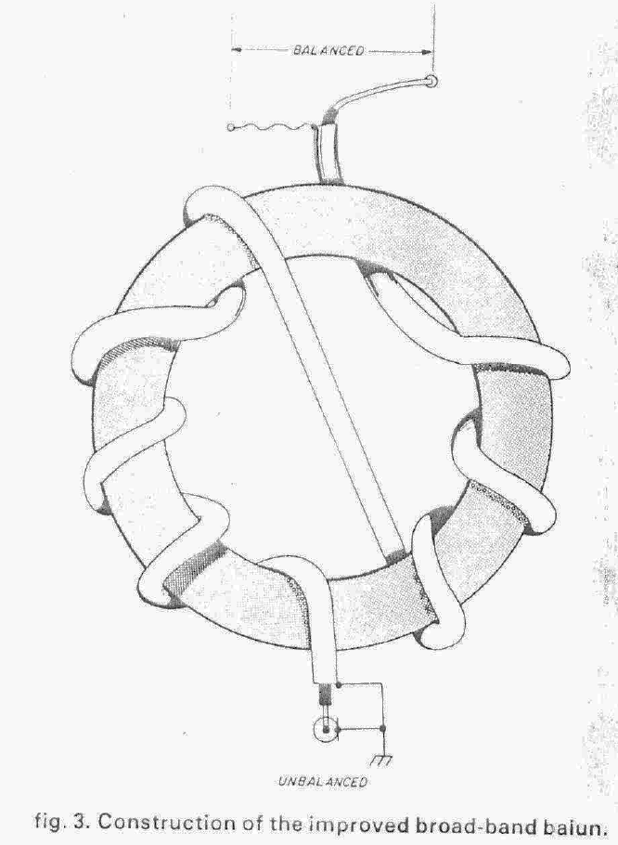
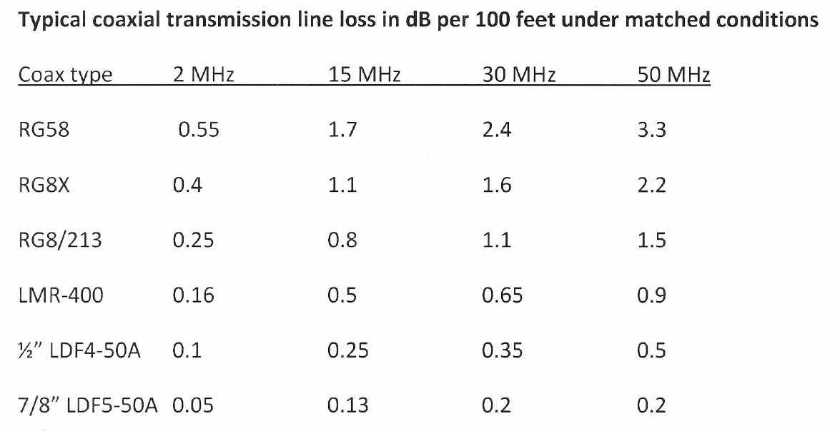
Transmission line losses and Baluns

Slide 11
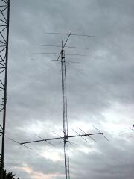
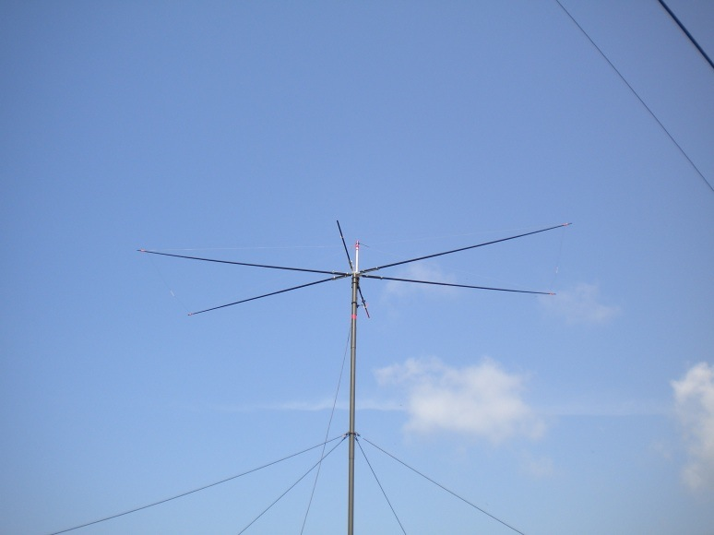
Antennas - HF
Monoband antennas (Ref. 2)
  Dipoles/Loops
  Verticals
  Full size: Yagi^{1 (Ref. 3)}
  Shortened: Moxon²
1
2

Slide 12
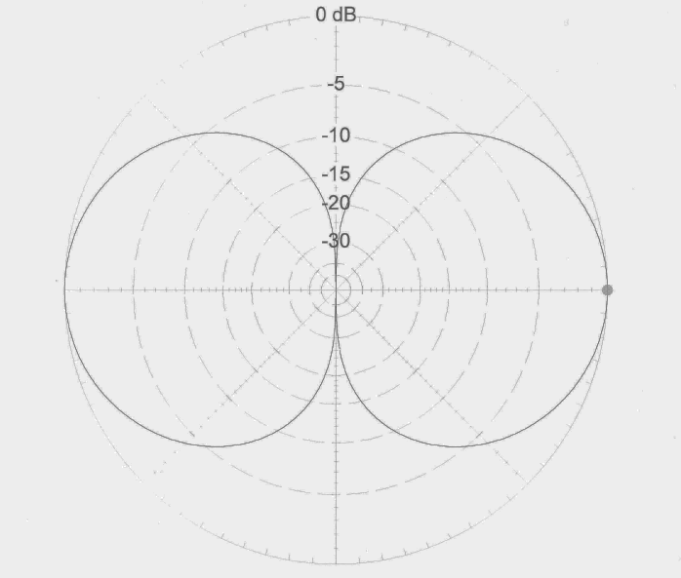
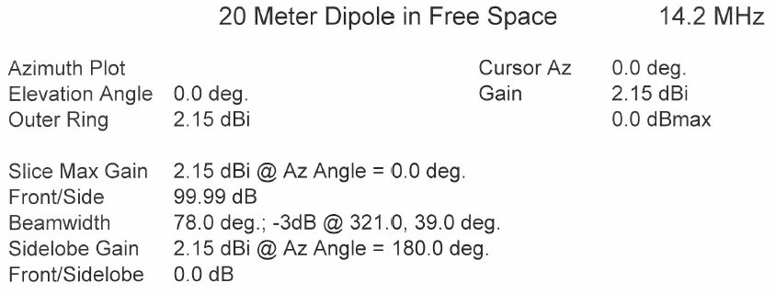
Antennas - HF

Slide 13
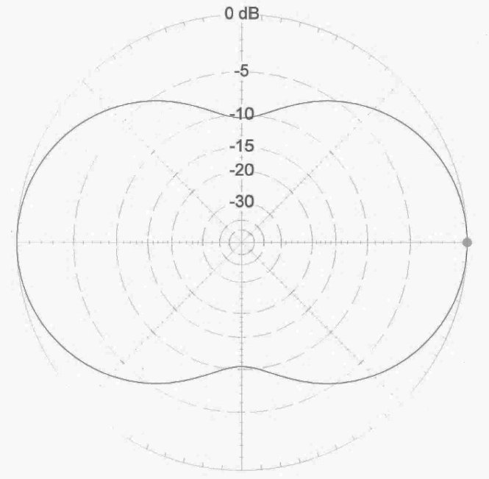
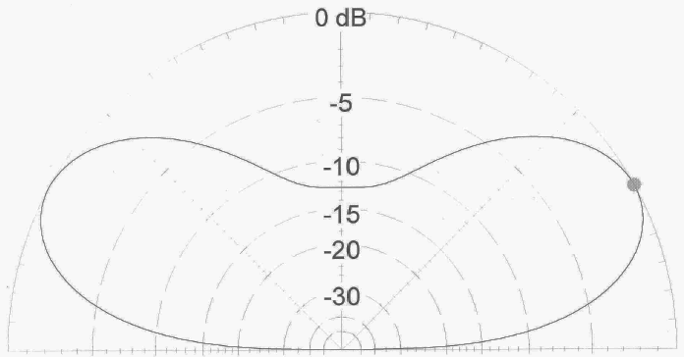

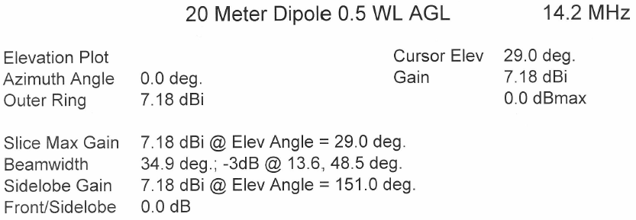
Antennas - HF

Slide 14
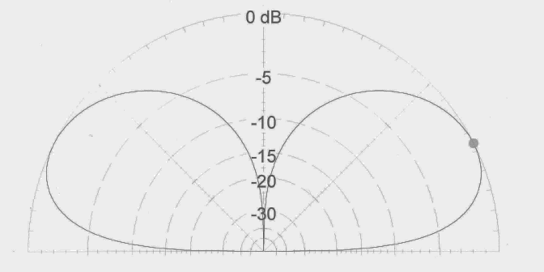
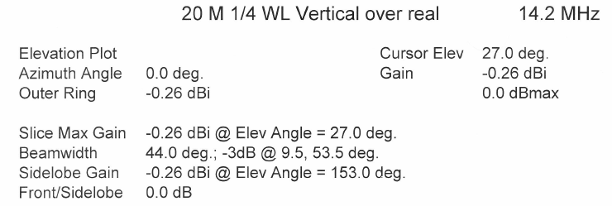
Antennas - HF

Slide 15
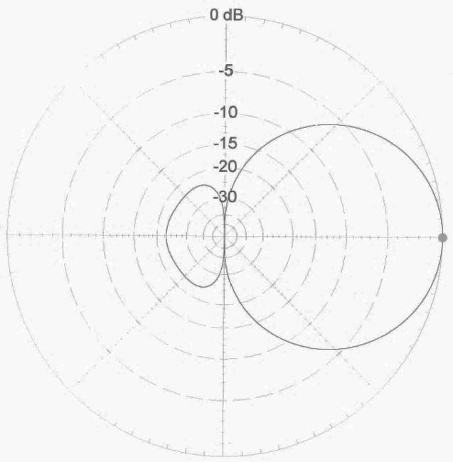
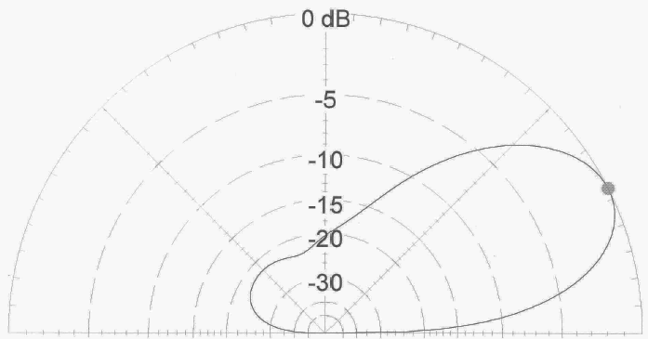
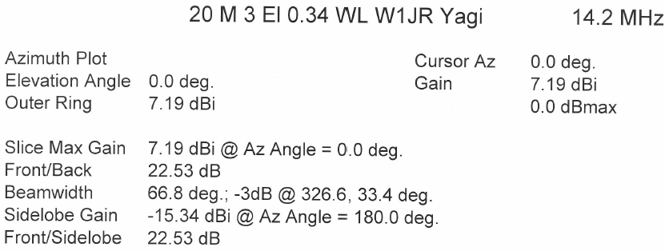
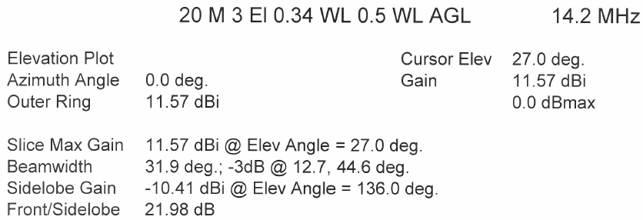
Antennas - HF

Slide 16
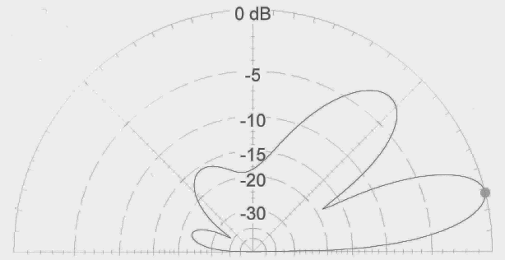
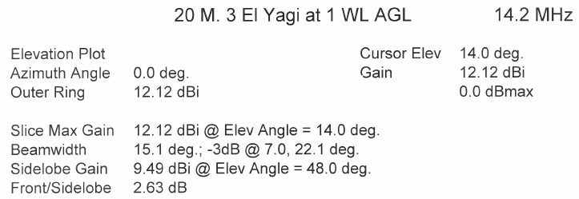
Antennas - HF

Slide 17
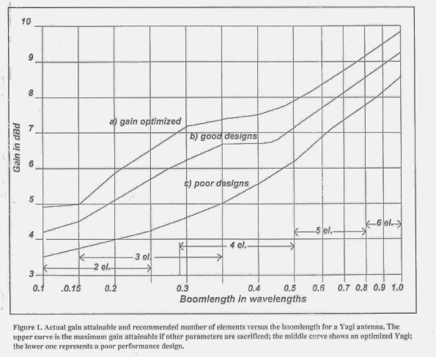
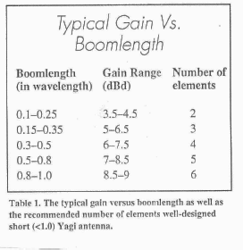
Antennas - HF

Slide 18
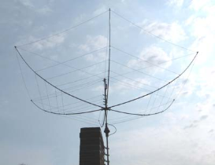
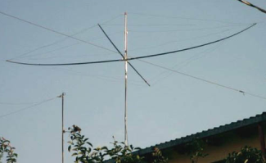
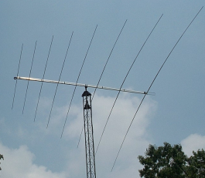
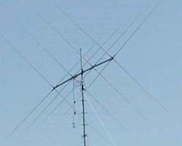
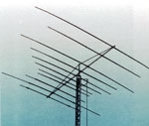
Antennas - HF
Multi-band antennas (Fixed)
Hexbeam¹
Spider beam²
Log periodic³
Quad⁴
Multiband Yagi⁵
1
2
3
4
5

Slide 19
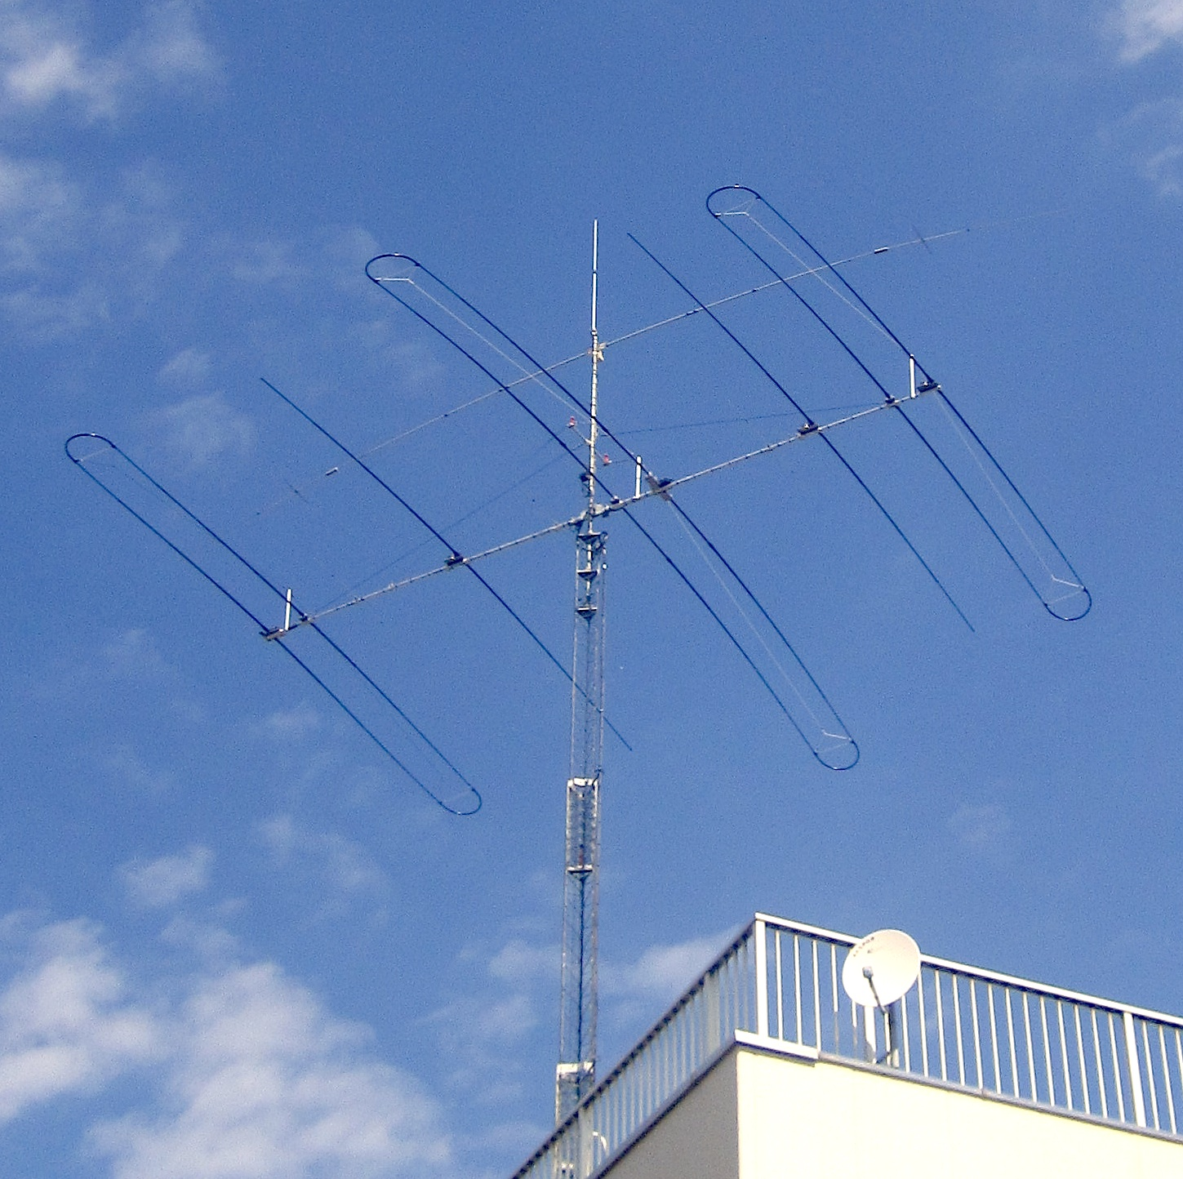
Antennas - HF
Adjustable
  SteppIR
  Many frequencies
  Optimum performance

Slide 20
Low frequency antennas (160, 80 & 40 m)
Transmit antennas (Ref. 4)
  Dipoles/Loops (as high as possible)
  Inverted “V” Dipoles
  Verticals with many radials (Ref. 6)
  Inverted “L”
  Loaded Towers

Slide 21
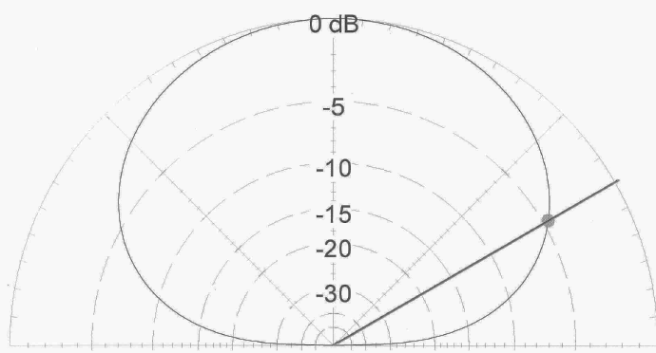
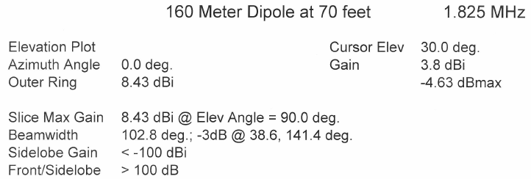
Antennas – Low Frequency (160, 80 & 40)

Slide 22
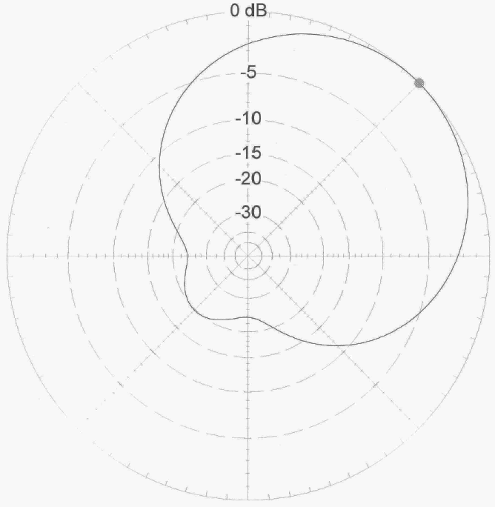
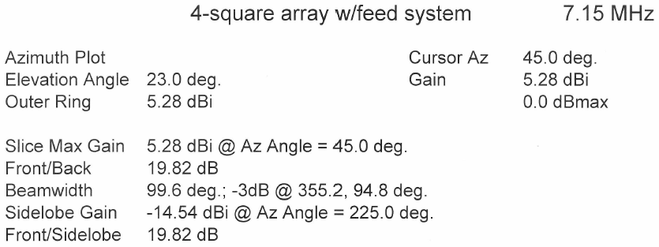
Antennas – Low Frequency (160, 80 & 40)

Slide 23
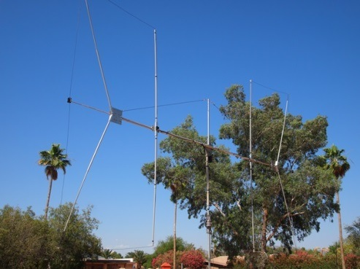
Low frequency antennas (160 & 80 m)
Receive antennas (Ref. 4)
  Beverages (Ref. 5)
  Loops (ground-dependent antennas)
  Flag/pennants (ground-independent antennas)
  3, 4 & 8 Element short vertical arrays
  Front end protectors

Slide 24
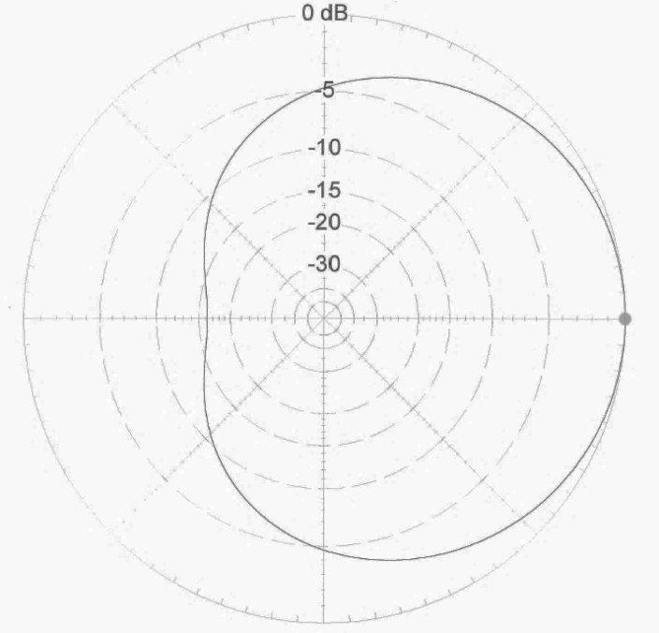
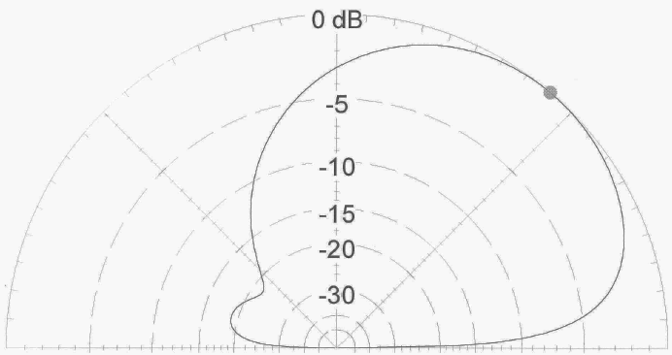
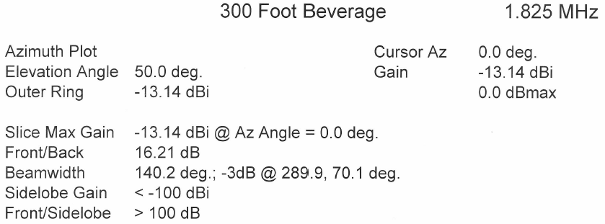
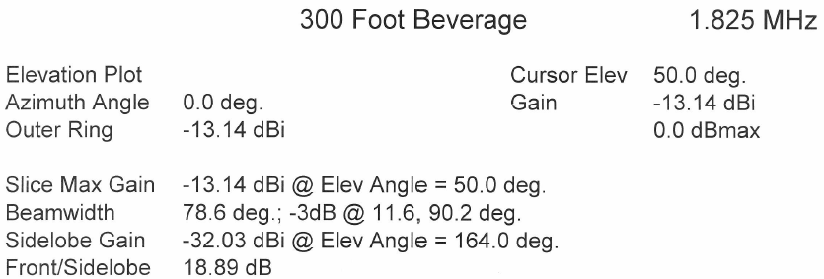
Antennas – LF Receiving Antennas

Slide 25
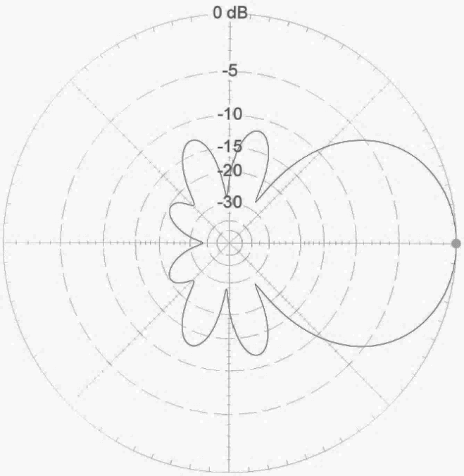
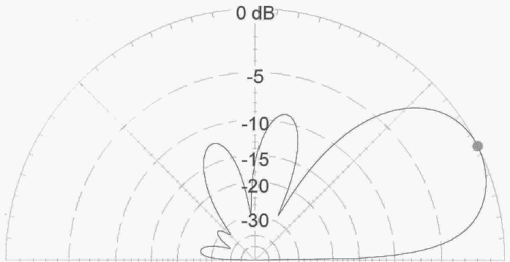
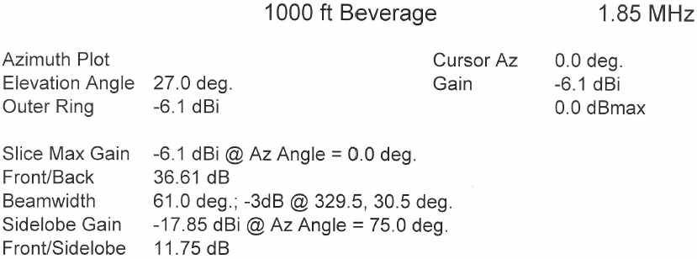
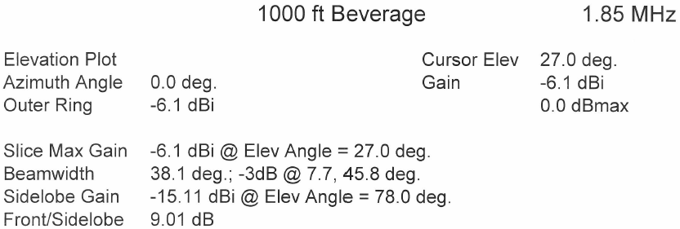
Antennas – LF Receiving Antennas

Slide 26
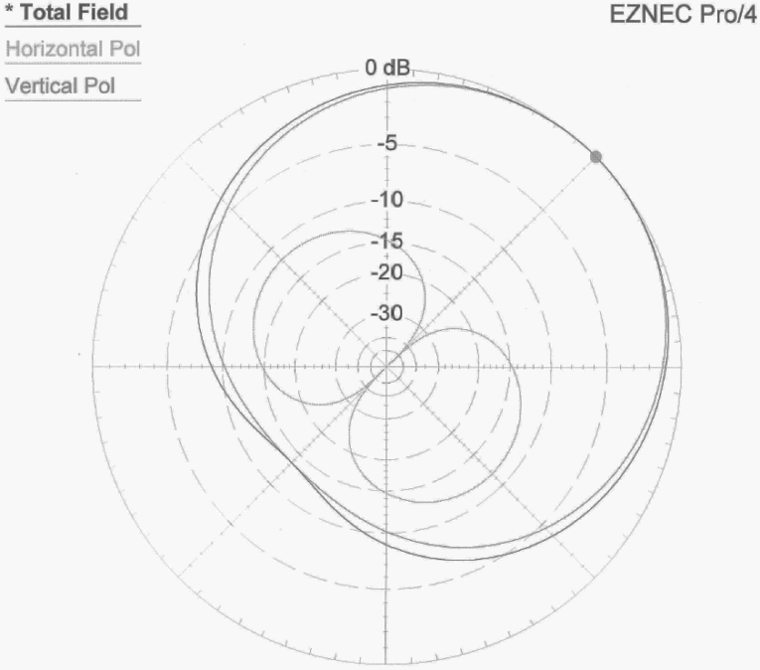
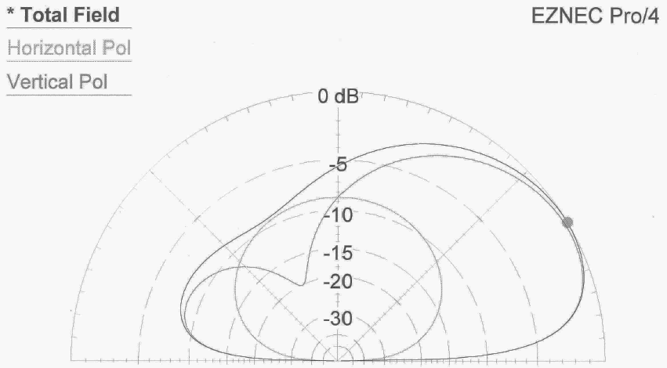
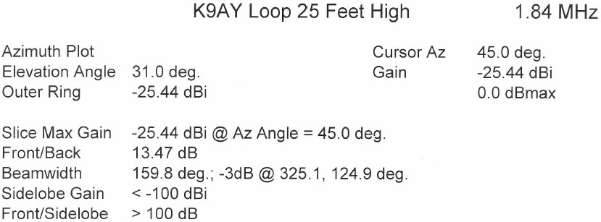
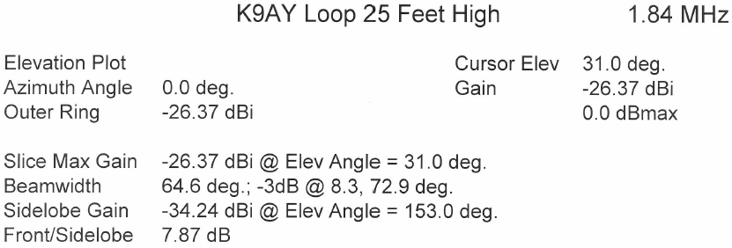
Antennas – LF Receiving Antennas

Slide 27

Other Station Elements
Grounding
  Grounding towers and antennas
  Nearby lightning strike protection
  Shock hazard mitigation
  Audio ground loop reduction

Slide 28


Other Station Elements
Filtering
  Harmonic suppression
  BCI reduction
  Protection of local equipment

Slide 29


Other Station Elements
Audio Transducers
  Headphones / speakers
  Microphones
  PC CODECs

Slide 30




Station Layout Considerations
Reduce stress and strain
  Organization of equipment
  Neck strain reduction
  Minimize eye strain
Lighting
  Must see the radio knobs
  Must see keyboards
Ambient sound
  Fan noise
  Clunking relays
Posterior comfort

Slide 31

AA7A Station – 10 Feb 2012 (at 1646 Z )
Rotor Display
HF Radio #1
HF SDR #3
HF Amplifier #2
SDR Display
HF Radio #2
HF Logging Computer mon #2
HF Logging Computer mon #1
HF Amplifier #1
12-channel Audio Mixer
HF Wattmeter
HF Amplifier #3

Slide 32

AA7A Station – Operator Focus
Secondary Focus
Primary Focus
Secondary Focus

Slide 33
Summary
1. Know your station and its capabilities.
2. Pay attention to the layout of your operating position.
3. The antenna is the most important part of you station.
4. Keep transmission line losses to a minimum.
5. Protect your station from electrical discharge.
Happy Hunting
Notes:
Summary

Slide 34
DXU References
Dean Straw, N6BV Propagation Charts
The ARRL Antenna Book
Yagi/Uda Design, Part 1: A Different approach, Joe Reisert, W1JR, PP-49-59, Communications Quarterly, Winter 1998
Low-Band DXing, 5th Edition, John Devoldere, ON4UN
Simple and Efficient Broadband Balun, Joe Reisert, W1JR, Ham Radio Magazine, September 1978, pg 12
N6LF website: (http://www.antennasbyn6lf.com/)
W1HIS website: (http://www.yccc.org/Articles/W1HIS/CommonModeChokesW1HIS2006Apr06.pdf)
K9YC website: (http://audiosystemsgroup.com/RFI-Ham.pdf)
Many thanks to Ned Stearns, AA7A for his original presentation of this material and his assistance in updating the material.
Joe Reisert, W1JR, revised 26 June, 2014

Slide 35
Notes:
Station and Antenna Considerations

