Slide 1
Having Fun with
RTTY DXing
Ed Muns, W0YK
15 April 2016

Slide 2
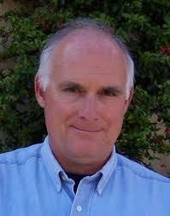
Ed Muns, W0YK
Ed’s primary interest in amateur radio is CW contesting and DXing. In 2004 he entered his first RTTY contest and has enjoyed the RTTY mode ever since. It has helped him improve his operating skills across all modes.
He is the contest director for the CQ RTTY contests (WW and WPX), the NCJ NA RTTY Sprint and co-sponsors the 10-Meter RTTY Contest with AA5AU. Ed also authors the RTTY Contesting column in the NCJ.
After 32 years with Hewlett-Packard Company as an engineer and executive, he now farms wine grapes on 13 of his 77 acres in the Santa Cruz Mountains. Muns Vineyard designated wine is found on several well known labels as well as on his own brand--Muns Vineyard.

Slide 3
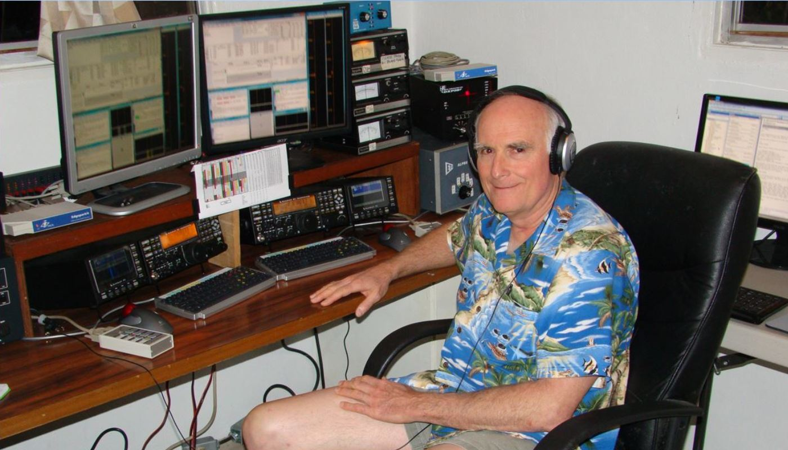
Ed Muns, W0YK
Operating here as P49X, Ed is also licensed as 7J1ACJ and has operated as YK0A, 6Y4A and HC8N.

Slide 4
Do You DX in RTTY mode?
VK0EK: 40, 30 & 15 (4.5% RTTY)
FT4JA: 40, 30, 20 & 15 (10% RTTY)
Did you work them on any mode?
  Did you call one of them on RTTY?
  Did you work one of them on RTTY?
  Did you work both of them on RTTY?

Slide 5
DXpedition Goals
Work everyone, not just ME!
Maximize uniques
  ATNOs
  QSL & donation funds
CW & SSB predominate
  10% RTTY, hopefully
  120-150 RTTY QSOs/hour

Slide 6
DXpedition Tactics
Emphasize CW
Delay RTTY operation
Constrain RTTY bands
  30 and 15 meters
  40, 20 and 15 meters
➔ Limited RTTY operation

Slide 7
DXpeditions
Position on Top Wanted list
Propagation
Number of active stations
Operator skill
➔ Pileup size

Slide 8
Pileup Size
Simplex or split
Spread bandwidth
QSO messaging
DX operator QSO pattern
➔ DXer strategy & tactics

Slide 9
DXer Strategy & Tactics
Station design
  Antennas, radios, amps, PCs, software, etc.
  Radio with 2 receivers; stereo headphones
Station configuration
  verification
  ergonomics
  familiarity
Practice

Slide 10
DXer Strategy & Tactics
Do homework on DXpedition
  Advance information
  DXpedition website: plans
Rally resources
  DXpedition website: tools
  Propagation aids
  Spotting network
  Reverse Beacon Network

Slide 11
DXer Strategy & Tactics
Listen
  Determine landscape
  Determine messaging
  Determine QSO pattern (His RX freq.)
Listen some more to verify
Setup to transmit
➔ Only then, transmit

Slide 12
DXer Strategy & Tactics
If you work them, congrats!
If not, then …
➔ Listen better
➔ Check station setup

Slide 13
QSO Pattern (His RX freq.)
Misdirect
Linger, then move monotonically
  Round trip or Reset
  Ping Pong the edges
  Don’t linger
Move randomly
  is it really random?
➔ Next RX freq?

Slide 14
Messages
VK0EK:
CQ VK0EK VK0EK CQ EU DN
W0YK 599 W0YK
W0YK TU VK0EK CQ EU DN
W0YK:
W0YK W0YK
TU 599 W0YK

Slide 15
Digital Modes
RTTY
  most common
  major DXpeditions
PSK
  low power
  long distance
JT65
others

Slide 16
RTTY Station
CW/SSB station
  Radio with dual receivers
RTTY interface
RTTY Decoder/Encoder
  MMTTY
  2Tone (requires a logger)
  GRITTY (decoder only)

Slide 17
Radio
Dual receivers for Split operation
  separate decoder on each
IF bandwidth: 500 Hz
AGC Off
Choose AFSK or FSK for transmit

Slide 18
AFSK vs. FSK
Two methods of transmission:
AFSK (Audio Frequency Shift Keying)
  keyed audio tones into Mic input
FSK (Frequency Shift Keying)
  keys the transmitter just like CW
Receiving is the same in either case.

Slide 19
AFSK vs. FSK
AFSK
Indirect (tones → Mic input)
Any SSB radio
SSB (wide) filtering
Dial = sup. car. freq.
VOX
Audio cable (same as PSK31)
Must use high tones
FSK
Direct (like CW keying)
“Modern” radios
RTTY (narrow) filtering
Dial = Mark freq.
PTT
COM FSK keying cable
Can use low tones

Slide 20
RTTY Interface
Receive portion:
  audio cable to PC SndCd; isolation xfrmr
  or, Commercial USB RTTY interface
Transmit FSK:
  keying cable to PC Com port (FSK & PTT)
Transmit AFSK:
  audio cable to PC SndCd; isolation xfrmr
  or, Commercial USB RTTY interface

Slide 21
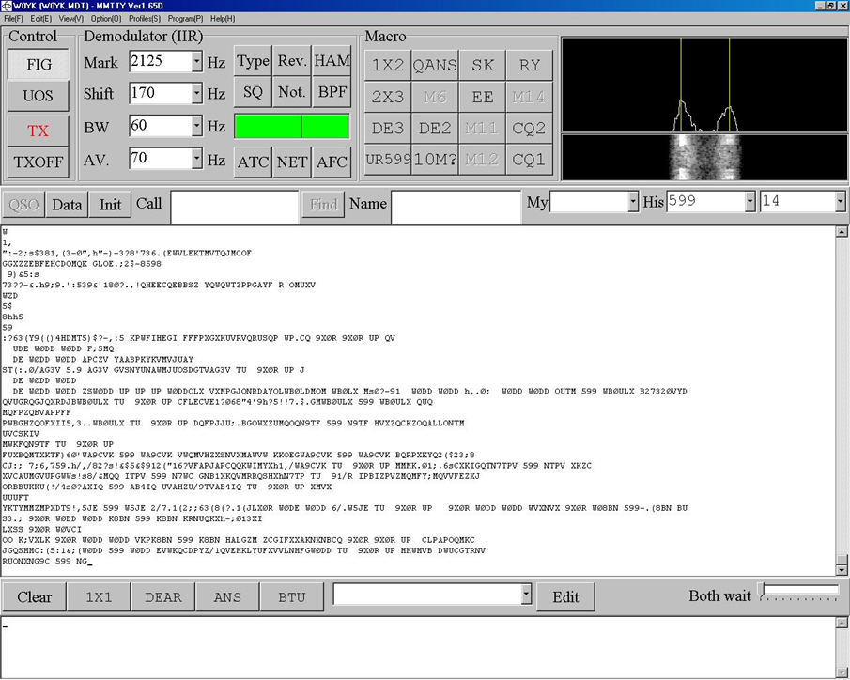
MMTTY decoder/encoder

Slide 22
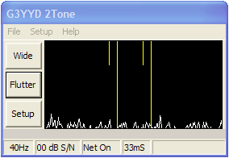
2Tone decoder/encoder
Requires logging software

Slide 23
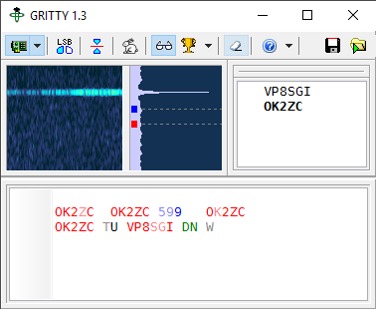
GRITTY decoder

Slide 24
What is RTTY?
A pair of redundant, reciprocal CW signals
  Mark and Space, 170Hz apart
  Baudot code, rather than Morse
Local tones are like CW pitch
  2295/2125 Hz default
60 WPM (45.45 Baud)

Slide 25
Resources
Website: www.rttycontesting.com
Email reflector: rtty@contesting.com
Dayton CTU RTTY presentations
NCJ RTTY Contesting column

Slide 26
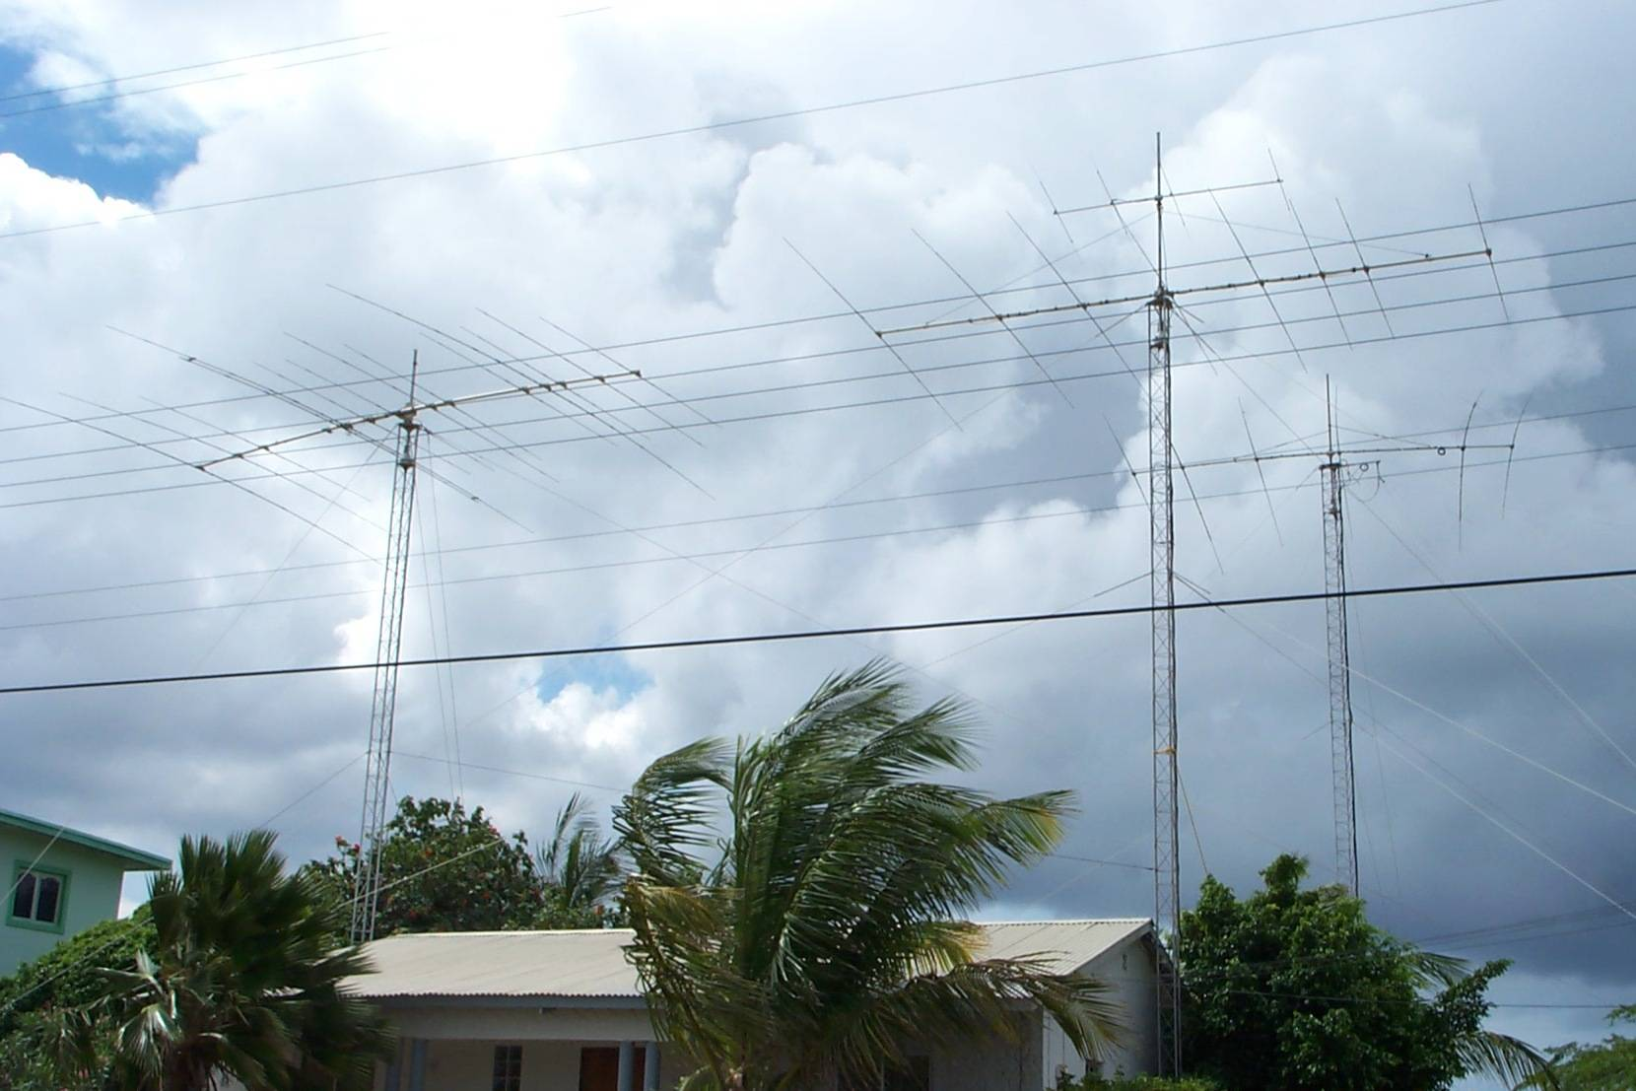
Happy RTTY DXing!

