Slide 1

International DX Convention
2016
Visalia, California
Notes:
Add Notes

Slide 2

The DX Chase: It Takes Two To Tango

Slide 3
Important:
“The DX Chase: It Takes Two To Tango – Part I” was written expressly to help DXpeditioners work European DXers.
Yet, all DXers can benefit by knowing what methods work best in top-twenty situations.

Slide 4
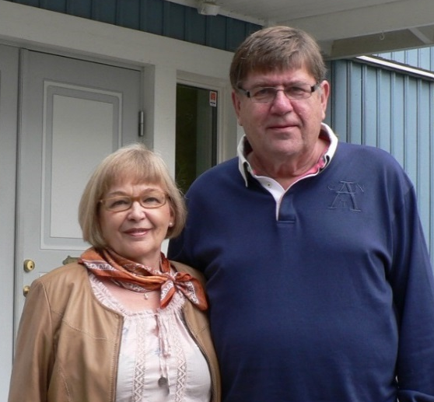
Part I
by
Martti J. Laine, OH2BH
“The pileup accurately mirrors the DXpedition operator who runs the show.”

Slide 5
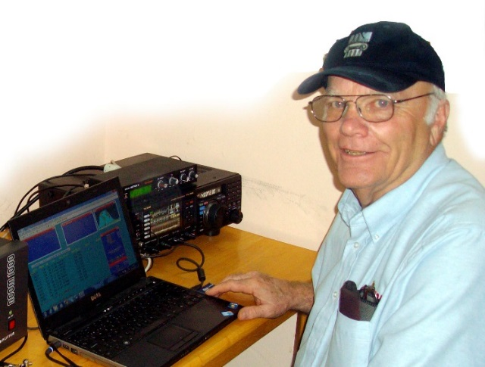
With an introduction
by
Wayne Mills, N7NG
N7NG at Z81X

Slide 6
Introduction
“The nature of North American pileups is reasonably consistent. The character of Japanese pileups is even more consistent. The quality of European pileups, on the other hand, is marked by diversity.” – OH2BH
What we have added to the usual discussion is a unique consideration of the differences in DXers’ language, culture and temperament that exist around the world – particularly in Europe….and we have really only scratched the surface.
Language…is very important, [and] to all of these, we have added a section on the DXpeditioner’s attitude. As in many aspects of life, a good, positive attitude is extremely important in DXpeditioning. These considerations are a work in progress, asking for thoughtful study by the world’s DXpeditioners.
Notes:
Notes on the introduction

Slide 7
It Takes Two to Tango, Part I

Slide 8
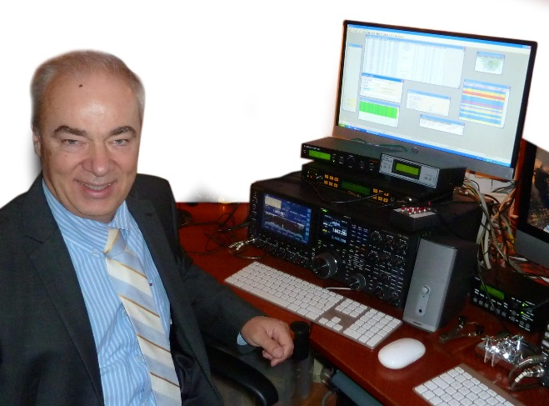
“If each European country were served in its own language, all instructions given by the DXpedition operator would undoubtedly be perfectly understandable and QSO rates would soar. But with no common language, Europeans are understandably less accountable for what they do or say.”
Mike, OE6MBG, a multi-lingual language professor interrelates languages and cultures in a variety of ways of responding to orders while here dressing for an occasion of 75M evening opening.

Slide 9
It takes Two to Tango, Part I
Section I
Learning and Understanding the Differences of the World
”You must talk to the European using the same, limited phonetic phrases* that he has adopted from English, sticking to clear and simple QSO content with reasonable speed and clarity.” To get an idea of the language difficulties English speaking DXpeditioners face, look carefully at the comments shown on the European DX spotting networks. If you think about it, it’s very revealing. *1 (grammar) a small group of words without a finite verb that together have a particular meaning and that typically form part of a sentence

Slide 10
Language differences are a significant problem.
Do not speak fast. Speak clearly, using simple language.
Keep it short and to the point.
Mike, OE6MBG, a multi-lingual language professor interrelates languages and cultures in a variety of ways of responding to orders while here dressing for an occasion of 75M evening opening.

Slide 11
I have heard recently that Japan is the new Italy. This because of difficulties controlling the JA masses from the pacific. Might this be a language problem? Here’s my “Aki” story from 9M0S…
Mike, OE6MBG, a multi-lingual language professor interrelates languages and cultures in a variety of ways of responding to orders while here dressing for an occasion of 75M evening opening.
Notes:
This is my 9M0S Aki Story

Slide 12

Section II
Attitude is Everything When Serving a Global Audience
“What is most important is to stay ‘cool.’ Do not yell at the pile up. Be a gentleman… the best you can. Remember you are on stage and the whole DX world is probably listening. Try to keep the pileup moving and flowing like beautiful music. If you only get a partial call, come back to what you have, and give the signal report. Let the station repeat his call, then CONFIRM his call and say THANK YOU. Keep it all short and sweet.”
Jerry, WB9Z at Malpelo, HK0NA is happy to be heading home. Even considering the unique landscape, ultimate heat with no sleep adds to the cause. Jerry stands well even for European disorder.

Slide 13
Attitude is Everything When Serving a Global Audience
Be a gentleman.
Keep the pileup moving.
Confirm calls carefully.
Keep it short – realize a good rate.
Jerry, WB9Z at Malpelo, HK0NA is happy to be heading home. Even considering the unique landscape, ultimate heat with no sleep adds to the cause. Jerry stands well even for European disorder.

Slide 14
Attitude is Everything When Serving a Global Audience
The first two sections of this paper are the most important – and perhaps unique.
DXpeditioners would do well to think carefully about this material.

Slide 15
Additional Sections: (This material is more routine but often neglected.)
III How to go about it in an actual situation – Listening Windows
IV The Dynamics of Filling the Window and Moving Along
V Splitting the Pileup Fairly and Making No Exceptions
VI A Conversational Style – Polite While Maintaining the Rate
VII The DXpedition Operator in Control of the Thundering Pileup
VIII The Profile of an Ideal Operator & How to Become One
IX Setting a Clear Strategy and Balancing Statistics

Slide 16
Additional Sections
III How to go about it in an actual situation – Listening Windows
IV The Dynamics of Filling the Window and Moving Along
V Splitting the Pileup Fairly and Making No Exceptions
VI A Conversational Style – Polite While Maintaining the Rate
VII The DXpedition Operator in Control of the Thundering Pileup
VIII The Profile of an Ideal Operator & How to Become One
IX Setting a Clear Strategy and Balancing Statistics

Slide 17
Additional Sections
III How to go about it in an actual situation – Listening Windows
Check list:
Check that your frequency is clear and GO!
Never respond to any stations on your transmitting frequency
Use a fixed split for a while to check conditions into different areas.
If necessary, go to a wider split
Go as wide as necessary, but consider your decision carefully.
The rate depends on the width of the window.

Slide 18
Additional Sections
III How to go about it in an actual situation – Listening Windows
IV The Dynamics of Filling the Window and Moving Along
V Splitting the Pileup Fairly and Making No Exceptions
VI A Conversational Style – Polite While Maintaining the Rate
VII The DXpedition Operator in Control of the Thundering Pileup
VIII The Profile of an Ideal Operator & How to Become One
IX Setting a Clear Strategy and Balancing Statistics

Slide 19
Additional Sections
IV The Dynamics of Filling the Window and Moving Along
Callers will adjust to your listening pattern.
Don’t say “spread out,” and then continue to listen in the same place.
Move your listening frequency,
Indicate your listening range,
Specify your listening frequency if necessary.
The goal is to spread out the pileup in order to minimize the density.
If it’s still to difficult, widen the width of the pile.

Slide 20
Additional Sections
III How to go about it in an actual situation – Listening Windows
IV The Dynamics of Filling the Window and Moving Along
V Splitting the Pileup Fairly and Making No Exceptions
VI A Conversational Style – Polite While Maintaining the Rate
VII The DXpedition Operator in Control of the Thundering Pileup
VIII The Profile of an Ideal Operator & How to Become One
IX Setting a Clear Strategy and Balancing Statistics

Slide 21
Additional Sections
V Splitting the Pileup Fairly and Making No Exceptions
Determining how to split the pileup requires balancing a complex
Set of variables. These include using a number of bullets:

Slide 22
Additional Sections
III How to go about it in an actual situation – Listening Windows
IV The Dynamics of Filling the Window and Moving Along
V Splitting the Pileup Fairly and Making No Exceptions
VI A Conversational Style – Polite While Maintaining the Rate
VII The DXpedition Operator in Control of the Thundering Pileup
VIII The Profile of an Ideal Operator & How to Become One
IX Setting a Clear Strategy and Balancing Statistics

Slide 23
Additional Sections
VI A Conversational Style – Polite While Maintaining the Rate
Running contest style rapid-fire QSOs is not the aim. A DXpedition
is not a contest. (Contesters can be DXpeditioners, rate is important,
but…)
Communicate with the pileup. Keep people informed.
If you plan Europe for the next three hours, say so.

Slide 24
Additional Sections
III How to go about it in an actual situation – Listening Windows
IV The Dynamics of Filling the Window and Moving Along
V Splitting the Pileup Fairly and Making No Exceptions
VI A Conversational Style – Polite While Maintaining the Rate
VII The DXpedition Operator in Control of the Thundering Pileup
VIII The Profile of an Ideal Operator & How to Become One
IX Setting a Clear Strategy and Balancing Statistics

Slide 25
Additional Sections
VII The DXpedition Operator in Control of the Thundering Pileup
The DXpedition operator in control of the thundering pileup.

Slide 26
Additional Sections
III How to go about it in an actual situation – Listening Windows
IV The Dynamics of Filling the Window and Moving Along
V Splitting the Pileup Fairly and Making No Exceptions
VI A Conversational Style – Polite While Maintaining the Rate
VII The DXpedition Operator in Control of the Thundering Pileup
VIII The Profile of an Ideal Operator & How to Become One
IX Setting a Clear Strategy and Balancing Statistics

Slide 27
Additional Sections
VIII The Profile of an Ideal Operator & How to Become One
A DXpedition is not a contest, but contesters can adapt to
DXpeditioning if they wish to do so. Learning DXpeditioning
Skills requires a humble attitude, observing and taking notes
About those that are more successful that you.
Working pileups down…requires [extensive] on-the-air experience…

Slide 28
Additional Sections
III How to go about it in an actual situation – Listening Windows
IV The Dynamics of Filling the Window and Moving Along
V Splitting the Pileup Fairly and Making No Exceptions
VI A Conversational Style – Polite While Maintaining the Rate
VII The DXpedition Operator in Control of the Thundering Pileup
VIII The Profile of an Ideal Operator & How to Become One
IX Setting a Clear Strategy and Balancing Statistics

Slide 29
Additional Sections
IX Setting a Clear Strategy and Balancing Statistics
Setting a Clear Strategy
Keep the stations on the air as much as condition allow.
Utilize your manpower smartly: The highest-rate ops for the
US and Eastern Europe.
Use your best European-oriented ops on SSB for Europe.
Using everyone for all operating slots is usually counterproductive.

Slide 30
Additional Sections
IX Setting a Clear Strategy and Balancing Statistics
Work to balance the statistics. Club Log is an excellent resource.
Carefully monitor the numbers of DXers on different bands, and in
different locations.

Slide 31
X The last idea: What about your opinion?
One more thing matters: Do you agree with the premises above?
If so, can you make them a reality? Do you have the skills?
These are time-tested methods; think about them. Will they work
for you?
If you can’t “buy-in,” or if you can’t lead your team to do so,
forget them. Do something else and see if works.

Slide 32
X What’s your opinion?
All teams need real leaders who can “make it happen.”
The leader is not the one who just signs the checks.
The real leader may not have even conceived the expedition.
But, the leader must have earned respect.
The most successful DXpeditions have effective leaders.

Slide 33

You can find The DX Chase: It Takes Two To Tango in its
entirety on the DX University site: www.dxuniversity.com

Slide 34
The DX Chase: It Takes Two To Tango, Part II
by
Wayne Mills, N7NG

Slide 35
It Takes Two to Tango, Part II

Slide 36
Topics
Introduction
Chasing Awards
Chasing DX – Conditions and Situations
Pileup Listening
Pileup Behavior – Are you aggressive? How much?
DQRM – What to do?
  How does increasing age affect our operating? Behavior?
  DXpeditions
  Innovations

Slide 37
Topics
Introduction
Chasing Awards
Chasing DX – Conditions and Situations
Pileup Listening
Pileup Behavior – Are you aggressive? How much?
DQRM – What to do?
  How does increasing age affect our operating? Behavior?
  DXpeditions
  Innovations

Slide 38
Introduction
Natural evolution…
More: DXers, bands, awards, conflicts, fun – or not
Less: Tolerance, space

Slide 39
Topics
Introduction
Chasing Awards
Chasing DX – Conditions and Situations
Pileup Listening
Pileup Behavior – Are you aggressive? How much?
DQRM – What to do?
  How does increasing age affect our operating? Behavior?
  DXpeditions
  Innovations

Slide 40
Chasing Awards
This isn’t about what awards are available. It’s about why we chase awards, and maybe how serious we are; how we are willing to go about achieving our goals. What are our standards?
Are we willing to “bend the rules?” Does it matter? How do we feel about using a remote station located on another side of the continent? The other side of the world? Would we try to get a confirmation for a QSO that never took place? Would we forge QSLs?
Things to think about…

Slide 41
Topics
Introduction
Chasing Awards
Chasing DX – Conditions and Situations
Pileup Listening
Pileup Behavior – Are you aggressive? How much?
DQRM – What to do?
  How does increasing age affect our operating? Behavior?
  DXpeditions
  Innovations

Slide 42
Chasing DX – Conditions & Situations
What do we need to consider before we call?
Are conditions good enough to offer a chance of a QSO?
How badly do we need the QSO?
Can we wait until there is less demand, or do we have a point to make?

Slide 43
Topics
Introduction
Chasing Awards
Chasing DX – Conditions and Situations
Listening to the pileup
Pileup Behavior – Are you aggressive? How much?
DQRM – What to do?
  How does increasing age affect our operating? Behavior?
  DXpeditions
  Innovations

Slide 44
Listening to the Pileup
Is the DX operation split?
Where the window is located?
How wide is the “window?”
What can I do without a spectrum scope?
(Can I use my ears, too?)

Slide 45
Listening to the Pileup
How long should our calls be?
Should we wait until conditions are better?
Where should we call?
What is the “best” radio type for split operation?

Slide 46
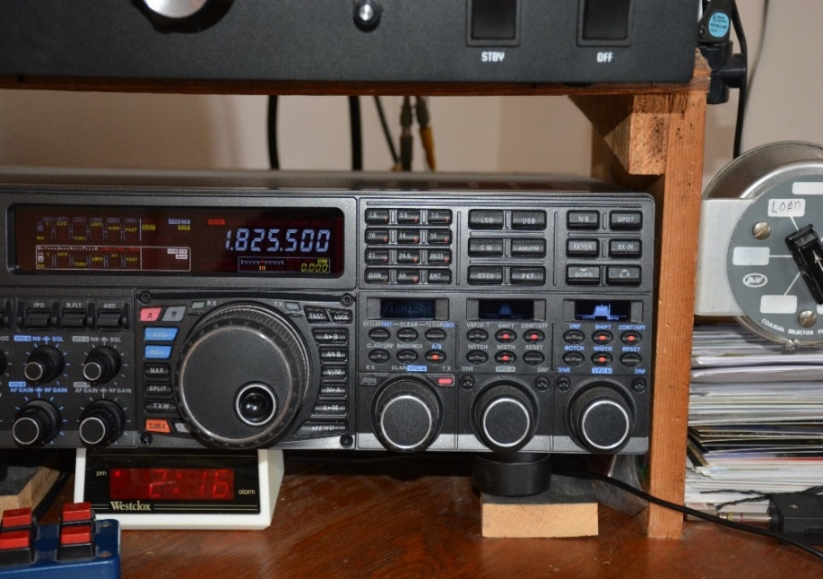
It may best to be able to listen to the DX and the pileup simultaneously. A band scope helps for large pileups.
You can use one “really” expensive transceiver or two less
expensive radios or even a transceiver and an extra receiver.

Slide 47
Topics
Introduction
Chasing Awards
Chasing DX – Conditions and Situations
Pileup Listening
Pileup Behavior – Are you aggressive? How much?
DQRM – What to do?
  How does increasing age affect our operating? Behavior?
  DXpeditions
  Innovations

Slide 48
Pileup Behavior – theirs and ours
Do we always understand what “the other guy” is hearing?
Sometimes there seems to be an assumption that what we hear is exactly what the other person hears. Does he/she understand the language?
How aggressive are you?
Sometimes DXers need to “settle” for what they get in a pileup. Not all DXpeditioners are “professional.”
Maybe “attitude is everything” in DXing as well as DXpeditioning.

Slide 49
Pileup Behavior
What is the best way to deal with others’ poor behavior in a pileup?
How should we react to people calling on the DX frequency?
Should we transmit on the DX frequency with “advice?”

Slide 50
How can we stop DXers from transmitting on the DX frequency?
Is current generation of ham radio equipment sufficiently “useable?” Should frequency control be made more user friendly?

Slide 51
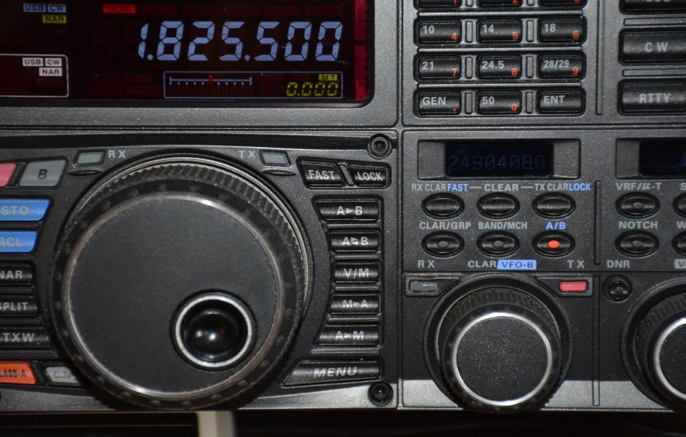
It there any wonder that we might occasionally end up on
the DXpedition frequency?
Even the most experienced DXers can make a mistake with this radio!
Could it possibly be easier? Could technology protect us?

Slide 52
Let’s talk to our radio manufacturers!

Slide 53
Topics
Introduction
Chasing Awards
Chasing DX – Conditions and Situations
Pileup Listening
Pileup Behavior – Are you aggressive? How much?
DQRM – What to do?
  How does increasing age affect our operating? Behavior?
  DXpeditions
  Innovations

Slide 54
DQRM: What to do about it?
What is DQRM? What is IQRM?
Who is creating DQRM?
Who is creating IQRM?
Why do you suppose people do these things?
(Have you ever asked yourself why?)

Slide 55
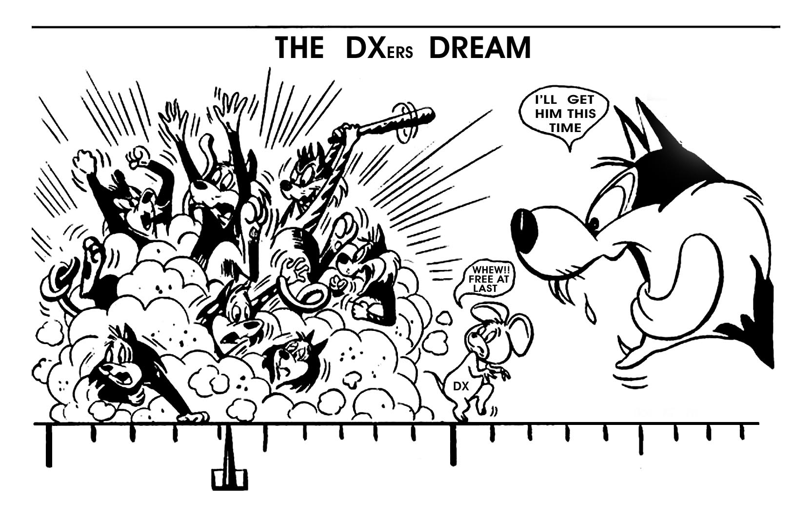
Can we take advantage of DQRM?

Slide 56
Topics
Introduction
Chasing Awards
Chasing DX – Conditions and Situations
Pileup Listening
Pileup Behavior – Are you aggressive? How much?
DQRM – What to do?
  How does our increasing age affect our operating? Behavior?
  DXpeditions
  Innovations

Slide 57
Our Aging Demographic
(Note the bigger font for those who need it…)
This is a serious issue.
California pamphlet for “older” drivers
How does increasing age affect our operating?
Our behavior?
I have seen serious examples….(besides myself of course)

Slide 58
Topics
Introduction
Chasing Awards
Chasing DX – Conditions and Situations
Pileup Listening
Pileup Behavior – Are you aggressive? How much?
DQRM – What to do?
  How does increasing age affect our operating? Behavior?
  DXpeditions
  Innovations

Slide 59
DXpeditions
What did pileups look like 10 years ago? Twenty? Fifty?
What will the “modern” pileup look like in ten years?
What will be the role of the Internet in ten years?
What might replace the Internet in DXing?
Is DXing “doomed?” Will it become irrelevant?

Slide 60
Topics
Introduction
Chasing Awards
Chasing DX – Conditions and Situations
Pileup Listening
Pileup Behavior – Are you aggressive? How much?
DQRM – What to do?
  How does increasing age affect our operating? Behavior?
  DXpeditions
  Innovations

Slide 61
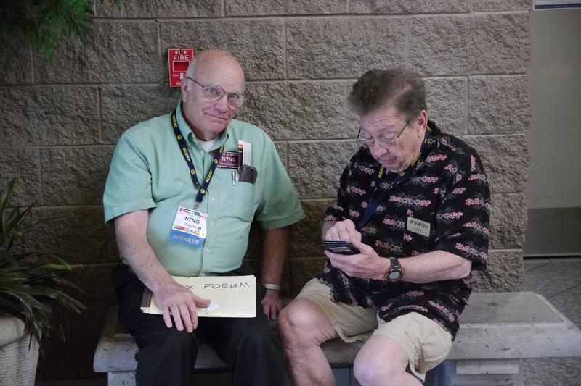
Innovations
A few words about Don Miller’s innovations:
Arguably created the modern pileup style of operating.
Rapid-fire QSOs – Fast CW.
Pileup management
Split operation
Advocate of “tail-ending,” and very competent in responding to it.
Don Miller in Visalia, 2015

Slide 62
Innovation
Within the Ham Radio service / hobby, there is very much a lack of willingness to change. (One reason the average age of hams is increasing so much.)
We should think in terms of new procedures and techniques.
Thinking outside the box: Is there a more effective – and sane – way for everyone to make a pileup QSO?
Maybe even eliminating the pileup altogether?
Would we want such an environment?

Slide 63
Mentoring
Lots of our problems can be solved through --- mentoring!
Are you a mentor? Could you be?
Can DXU help?

Slide 64
Summary

Slide 65
Discussion? Comments?

Slide 66
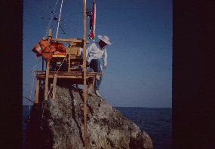

Slide 67
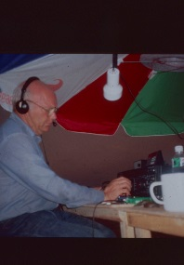

Slide 68
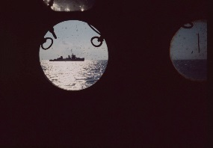

Slide 69
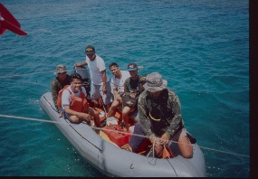

Slide 70
Thanks for listening!

