Slide 1

DX University
Visalia California – 2014

Slide 2
Propagation for Working DX
Carl Luetzelschwab K9LA

Slide 3
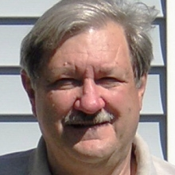
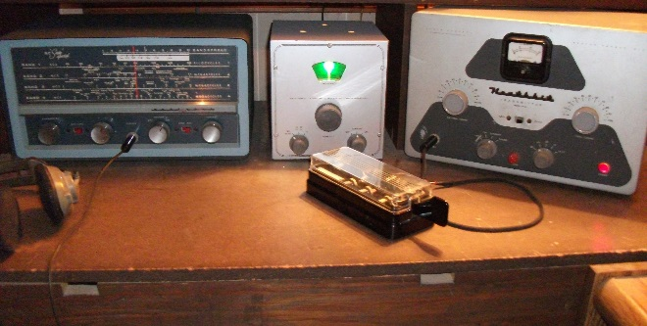
Carl Luetzelschwab K9LA
Carl was licensed as WN9AVT in October 1961. He selected K9LA in 1977 when the FCC offered 1 x 2 call signs to Extra Class licensees.
Carl enjoys propagation, DXing, contesting (he was the Editor of The National Contest Journal from 2002-2007), antennas and vintage rigs.
He earned a BSEE and MSEE from Purdue University, and retired in late 2013 as an RF design engineer with Motorola (1974-1988) and Raytheon (1988-2013).
Carl is a card checker for both ARRL and CQ awards, is at the Top of the DXCC Honor Roll, and enjoys viewing old QSLs (especially from deleted entities).
WN9AVT/WA9AVT

Slide 4
Propagation for Working DX
In this presentation I will address three issues
  When is the best time to work the DX station?
  Which way should I point my antenna?
  What should I do when propagation is disturbed?
References for your home library
  Robert Brown NM7M (SK) “The Little Pistol’s Guide to HF Propagation” - available at http://k9la.us – moderate reading
  The NEW Short Wave Propagation Handbook (W3ASK-N4XX-K6GKU, CQ, 1995) – light reading
  Radio Amateurs Guide to the Ionosphere (Leo McNamara, Krieger Publishing, 1994) – moderate reading
  Ionospheric Radio (Kenneth Davies, Peter Peregrinus Ltd, 1990) – heavy reading
Visit http://k9la.us – timely topics, basic concepts, tutorials, general, 160m, HF, VHF, contesting and webinars on propagation

Slide 5
Propagation for Working DX – Best Time
When is the best time to work the DX station?
HF propagation is due to refraction in the ionosphere
The ionosphere varies considerably
Amount of ionization varies by latitude
  Highest MUFs at low latitudes (around the equator)
  Lowest MUFs at high latitudes (polar regions)
  Most of us are in between those two extremes
Amount of ionization varies over time
  Long-term – over a solar cycle
  Mid-term – throughout the seasons
  Short-term – throughout the day and even day-to-day
And then there are anomalies!

Slide 6
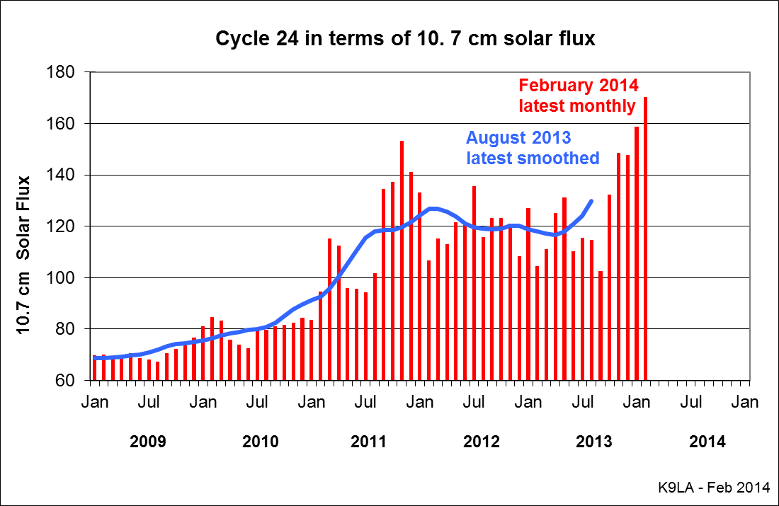
Propagation for Working DX – Best Time
Ionosphere varies over a solar cycle
  Approximately 11 years from min to max
  Higher bands (15/12/10) depend on ionization (MUF) - best at solar max – where we are now – during day
  Lower bands (160/80/40) depend on ionospheric absorption – generally best at solar min – during night
  Mid bands (30/20/17) hold up throughout solar cycle
Cycle 24 is the lowest in our lifetimes
Fortunately it is exhibiting a second peak right now
Second peak higher than first peak
Higher bands in great shape now

Slide 7
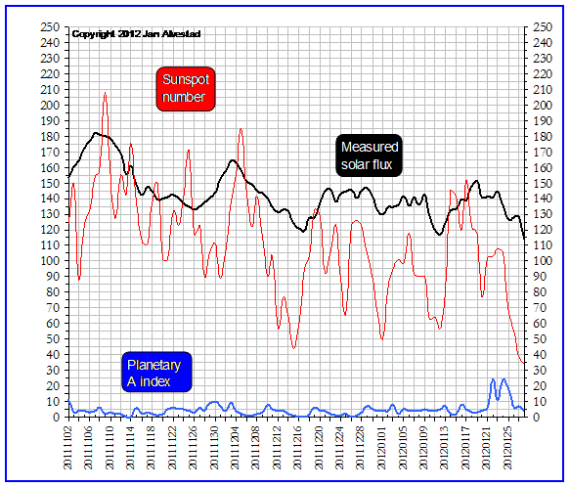
Propagation for Working DX – Best Time
Higher bands and 6-Meters
Needed ‘long-term’ solar flux or sunspot number for F₂ openings
  6-Meters: SFI > 200 or ssn > 100
  10-Meters: SFI > 100 or ssn > 50
  12-Meters: SFI > 75 or ssn > 35
  15-Meters: SFI > 50 or ssn > 25
All bands
Ap index less than 7 indicates quiet geomagnetic field
  Over the pole paths (high latitude) are best
The Big Picture – SFI, SSN, Ap
http://www.solen.info/solar/

Slide 8
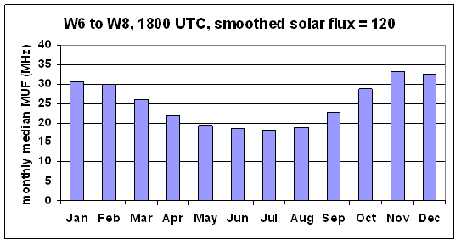
Propagation for Working DX – Best Time
Ionosphere varies throughout the seasons
  Composition of the atmosphere changes throughout the year
    More F₂ region ionization targets (atomic oxygen) in the fall, winter and spring months in the northern hemisphere generally results in higher MUFs in these months

Slide 9
Propagation for Working DX – Best Time
Ionosphere varies throughout the day
  The MUF maximizes during the day and minimizes during the night – but not the same values on consecutive days
Anomalies in the ionosphere
  For example, there are three areas in the world where the MUF maximizes during the night
    Around Japan, off the northeast coast of North America and over the Weddell Sea near Antarctica
So how do you make sense of all this variability?
  On the lower bands, the best times are when the path is in darkness – especially around sunrise/sunset times
  On the higher bands, the best times are when the path is mostly in daylight – in other words, point your antenna towards the Sun

Slide 10
Propagation for Working DX – Best Time
For more specific predictions . . .
Propagation prediction software packages available
For example, two free ones are
  VOACAP
    Voice of America’s version of IONCAP
  W6ELProp
    More user friendly than VOACAP
    Has a very useful mapping application that includes great circle paths and the terminator so you can see how your RF gets from Point A to Point B
Tutorials for these two are available at http://k9la.us
  Includes download instructions, set up instructions and interpretation of results

Slide 11
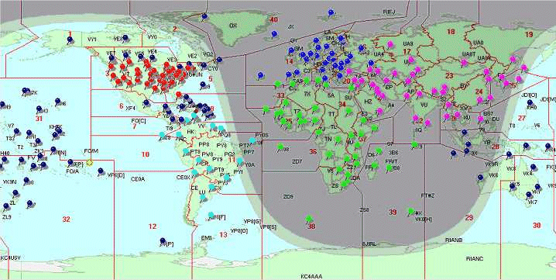
Propagation for Working DX – Best Time
If you don’t want to roll your own . . .
Use the predictions by N6BV
Over 240 locations worldwide
Over six phases of a solar cycle
Summary predictions to seven continental areas (EU, FE, SA, AF, AS, OC, NA) on 80m, 40m, 20m, 15m, 10m
Detailed predictions to all forty CQ zones on 160m – 10m (including 30m, 17m and 12m)
http://radio-ware.com/books/N6BV.html
Predictions from any pin to any other pin

Slide 12
Propagation for Working DX – Which Way
Which way should I point my antenna?
Purpose of an antenna is to put the most energy
  at the required azimuth angle (N, NE, E, etc)
  at the required elevation angle (10º, 20º, etc)
  with the required polarization (horizontal, vertical, circular)
The ionosphere dictates these three parameters
Biggest misconception may be that the higher the antenna, the lower the ‘radiation angle’ and thus the better the signal strength
  But the ionosphere determines the elevation angle that gets from Point A to Point B, not the antenna
  At times a higher angle is best

Slide 13
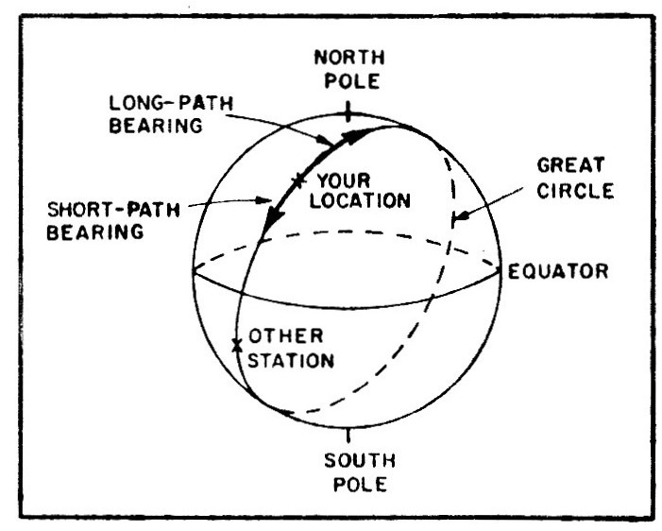
Propagation for Working DX – Which Way (azimuth)
An electromagnetic wave travels in a straight line unless it is refracted, reflected, or scattered
Shortest distance between two points on a globe is a great circle path
  This is short path - airliners generally fly short great circle paths to use the minimum amount of fuel (exceptions due to storms, winds, etc)
Other way around is long path
Location on opposite side of Earth to your location is called your antipode
  Short path and long path are equal – approx 20,000 km (12,500 miles)
ANTIPODE
Most of the time short path is best – sometimes long path is better – at other times gray line is best

Slide 14
Propagation for Working DX – Which Way (azimuth)
Most of the time a great circle path is dictated
  Skewed paths and scatter paths sometimes available
Use W6ELProp mapping feature to see the great circle paths (and the terminator)
With respect to polarization, circular polarization is predominant on the higher HF bands
  Horizontal or vertical equally good
    Only down 3 dB if the gains are the same
  Preference is horizontal antenna
    Vertical antenna picks up more man-made noise and is more ground dependent

Slide 15
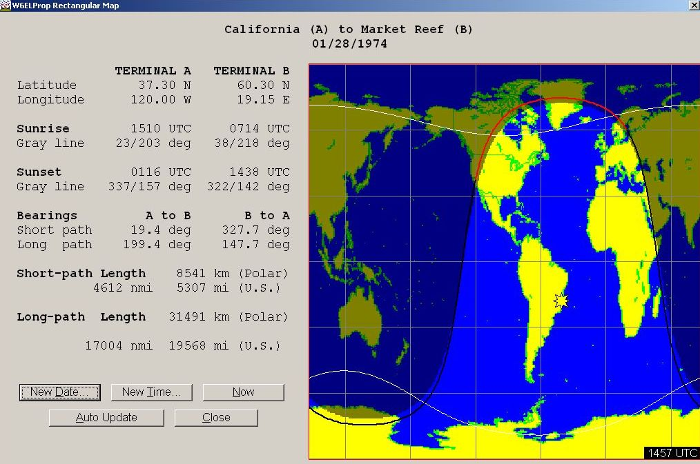
Propagation for Working DX – Which Way (azimuth)
Example: W6 to EU on 75-Meter LP via gray line
Generally occurs from November thru March
Around W6 sunrise
Good signal strengths without high power levels and without big antennas
Example shown is classical “gray line” propagation
Good example of the mapping application in W6ELProp

Slide 16
Propagation for Working DX – Which Way (az)
Example: 10-Meter LP for North America
For W6, evening long path to EU is probably most productive

Slide 17
Propagation for Working DX – Which Way (elevation)
Elevation angles required on 10-Meters for Indianapolis
Indianapolis to the world by continent (including USA) on 10-Meters
N6BV data on the CD-ROM in the 2012 ARRL Antenna Book (22nd Edition)

Slide 18
Propagation for Working DX – Which Way (elevation)
Antenna elevation patterns
5-element HyGain monobander over average ground

Slide 19
Propagation for Working DX – Which Way (elevation)
Superimpose required elevation angles on antenna patterns
Data available on other bands
To cover all the elevation angles, probably need stack of antennas
Tough to achieve low angle radiation on low bands
At 25 ft (red) – doesn’t cover the low angles (< 10º) very well
At 100 ft (purple) – covers the low angles, but has two nulls at 10º and 20º
At 50 ft (blue) – probably the best height overall for a single Yagi – 1.5 λ

Slide 20
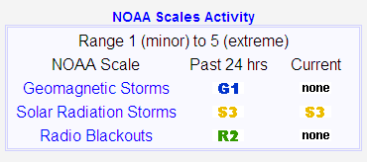
Propagation for Working DX – Disturbances
The Big Picture – Disturbances to Propagation
Review summary conditions at http://www.swpc.noaa.gov/
G = Geomagnetic storm - disturbance in the Earth’s magnetic field caused by gusts in the solar wind that blow by Earth (CMEs and coronal holes)
S = Solar radiation storm – disturbance in the polar cap due to increased levels of energetic protons
R = Radio blackout – disturbance on the daylight side of Earth due to increased electromagnetic radiation at X-ray wavelengths
Each is on a scale of 1 (minor) to 5 (extreme)
More details at http://www.swpc.noaa.gov/NOAAscales/

Slide 21
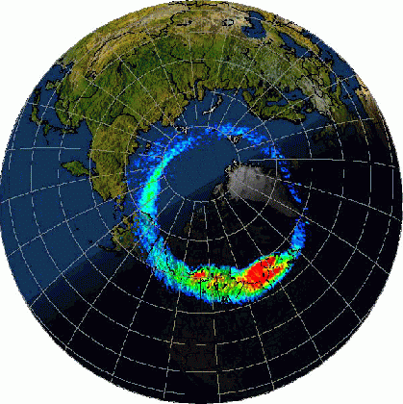
Propagation for Working DX – Disturbances
Disturbances to Propagation – A Visual Picture
2) Solar radiation storm (a.k.a. PCA) – increased D region absorption in the polar cap due to energetic protons from a big solar flare
1a) Geomagnetic storm – decreased F2 region MUFs at high and mid latitudes both day and night
X
North magnetic pole
3) Radio blackout – increased absorption on daylight side of Earth due to extremely short wavelength electromagnetic radiation from a big solar flare
1b) Geomagnetic storm – increased auroral ionization causing increased absorption and horizontal refraction (skewed path)

Slide 22
Propagation for Working DX – Disturbances
What can you do to mitigate a disturbance?
Geomagnetic storm – effect can last up to a week
  Check for auroral propagation at VHF
  Check for skewed paths on 160m
  Move down in frequency on HF paths thru mid and high latitudes
  Look for enhanced low latitude paths (e.g., southern USA to VK/ZL)
Solar radiation storm – effect can last up to several days
  For paths over the poles, try long path if the short path is degraded and vice versa (since the effect is not necessarily similar in the north and south polar caps)
Radio blackout – effect can last up to several hours
  Move to the higher frequencies
  Use paths that are in darkness

Slide 23
Propagation for Working DX – Summary
When is the best time to work the DX station?
  Lower bands – solar min, night, special attention around sr/ss
  Higher bands – solar max, path mostly in daylight (can tolerate some darkness)
  Use propagation predictions to pin down more specific times
Which way should I point my antenna?
  Use propagation predictions and mapping feature to identify short path, long path and gray line path
  Short great circle path best most of the time
  Need to cover the required elevation angles
  Polarization is an issue on 160-meters
What should I do when propagation is disturbed?
  Try the suggestions on the previous slide – no guarantees!
Read, read, read to understand more

