Slide 1


Awards, Contests and DXing

Slide 2


Agenda
Mini Bio
Awards and DXing
Contests and DXing
Wrap-Up

Slide 3

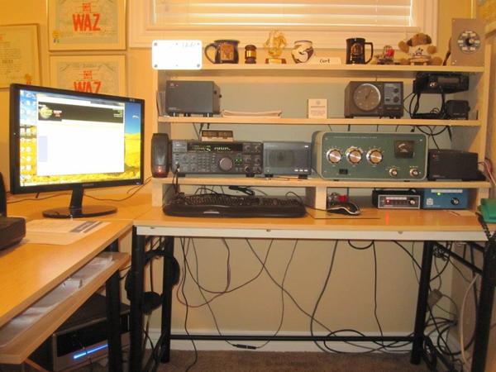

Originally licensed in 1961 as KN1TMK in Maine. My early years were spent on CW traffic nets. I began DXing in 1977 when I lived in Atlanta. I enjoy the challenge of DXing and chasing challenging awards.
7BDXCC, DXCC Honor Roll (mixed), various WAZ and other awards.
I am the Utah CQ Awards checkpoint.
I belong to the Utah DX Association, NCDXF, and the ARRL.
I am married to the former Sharon Pratt; we have 9 harmonics and 19 sub-harmonics.

Slide 4
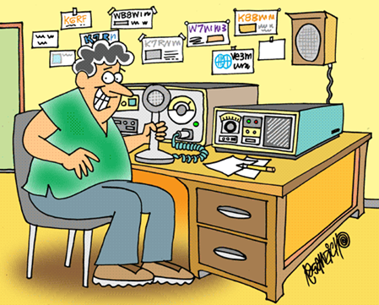
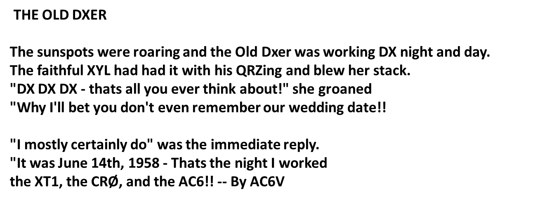

DX IS

Slide 5

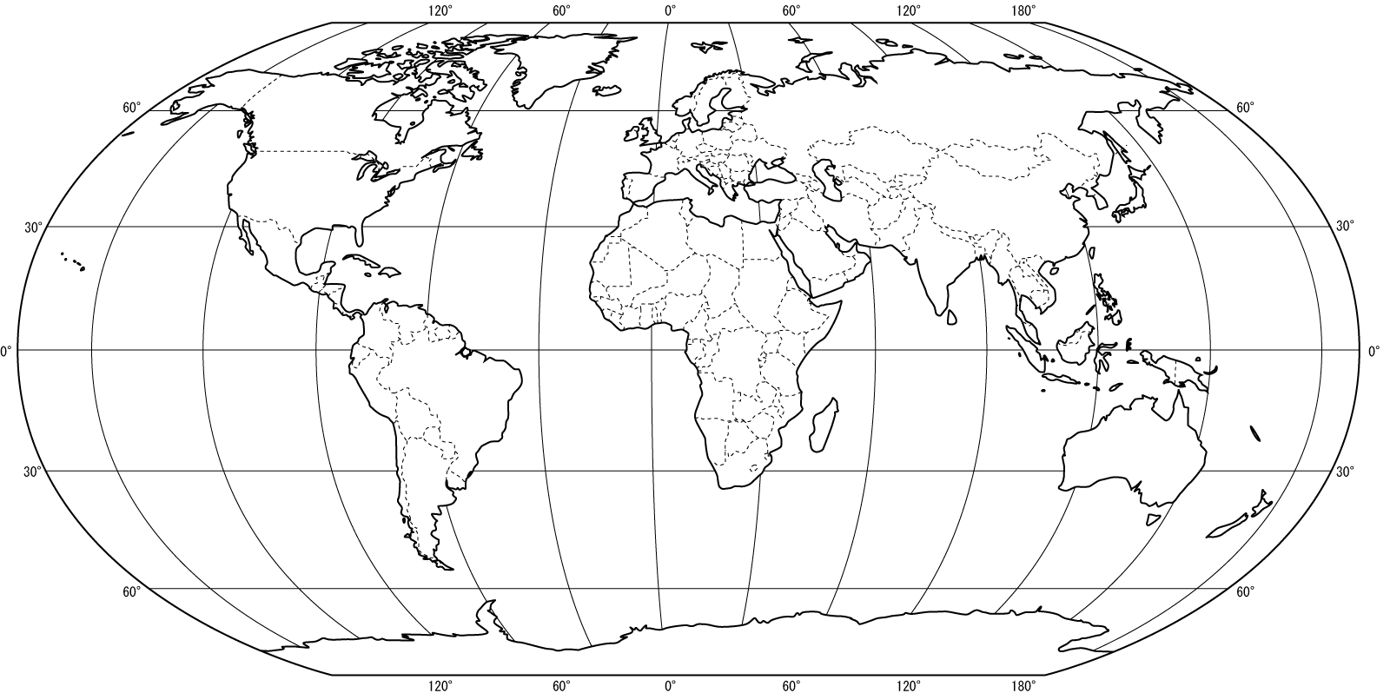

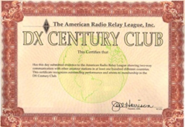

Awards and DXing

Slide 6
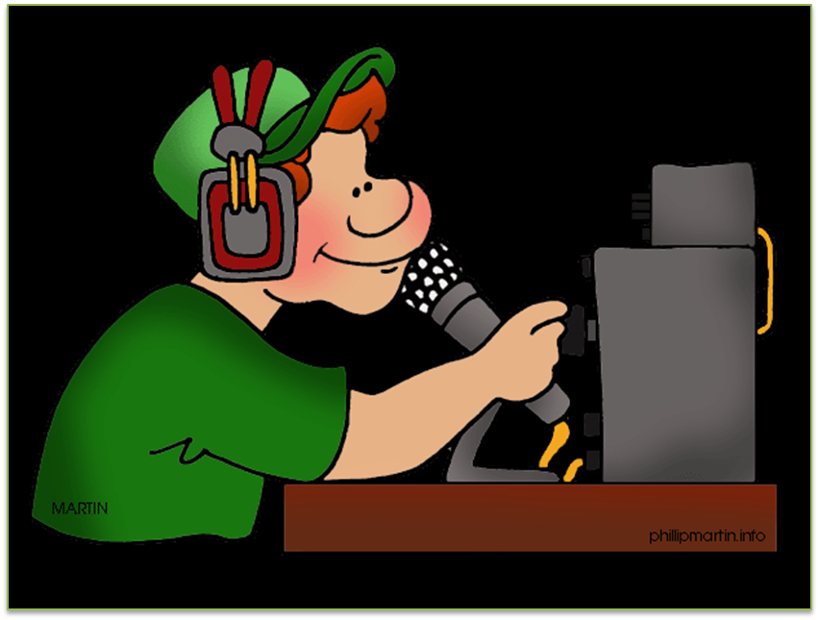
Awards and DXing
Ahh….just another VK; a VK1??!! ….I need that!!!

Slide 7


WA-VK-CA

Slide 8
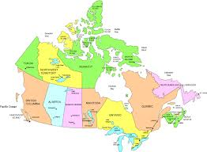

CANADAWARD
VO1-VO2 Newfoundland-Labrador
VE4 Manitoba
VE1 Nova Scotia
VE5 Saskatchewan
VE1-VE9 New Brunswick
VE6 Alberta
VY2-VE1 Prince Edward Island
VE7/VA7 British Columbia
VE2/VA2 Quebec
VE8 Northwest Territories
VE3/VA3 Ontario
VY1 Yukon
VY0 Nunavut

Slide 9
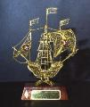
Awards and DXing
Rede dos Emissores Portugueses

Slide 10


Awards and DXing
DE Freq DX Time Comment
WB9EEE 7091.0 W1AW/0 0459z 26 Feb RTTY up 1
R9OZ 14070.9 BD9XE 0459z 26 Feb BPSK31 JACK
WA2WMJ 10107.0 EA9/DL2RVL 0458z 26 Feb TU NICE SIGNAL TO NY JB
N0UN 14242.0 A41KJ 0458z 26 Feb CQ
RA9CTV 14144.0 RM22CC 0457z 26 Feb cq cq
G4UFK 1850.0 W2RLB 0457z 26 Feb hearing you just abt
YV4MT 7179.0 W1AW/0 0457z 26 Feb QSX 7.181. Kansas. Tnx.
UT8IT 14070.8 ZZ80DF 0456z 26 Feb BPSK31 LABRE - 80 YEARS
W6RK 10105.0 EA8OM 0456z 26 Feb
K6MKF 28493.0 T77LA 0456z 26 Feb This is another test test test

Slide 11

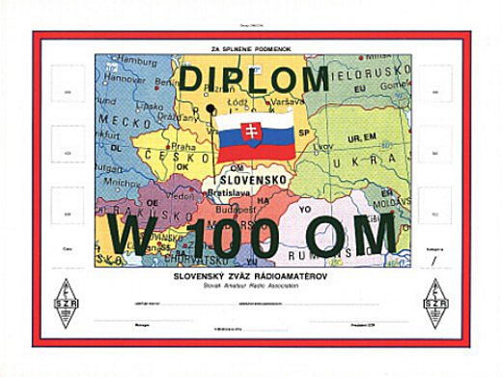
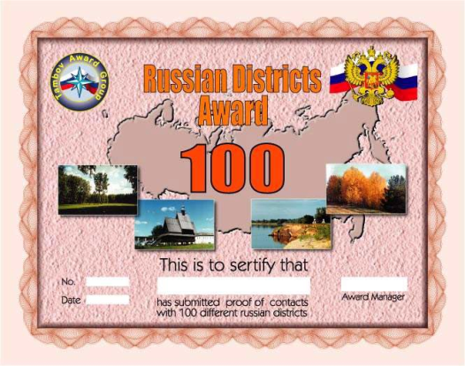

Awards and DXing
www.dxawards.com

Slide 12
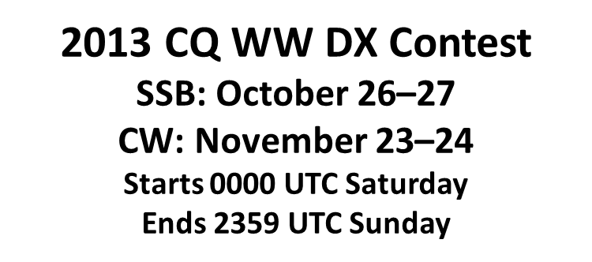



Contests and DXing

Slide 13
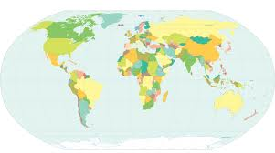

Contests and DXing
12-Month Contest Calendar
http://www.hornucopia.com/contestcal/index.html

Slide 14
Contests and DXing
Dupe Sheet
A | K6R, K7U. K7AL. AA7
B | WA5LT, NN5, NN5B,
C | NY6
D
E
F
G | N0T, K1D
H

Slide 15

Contests and DXing

Slide 16
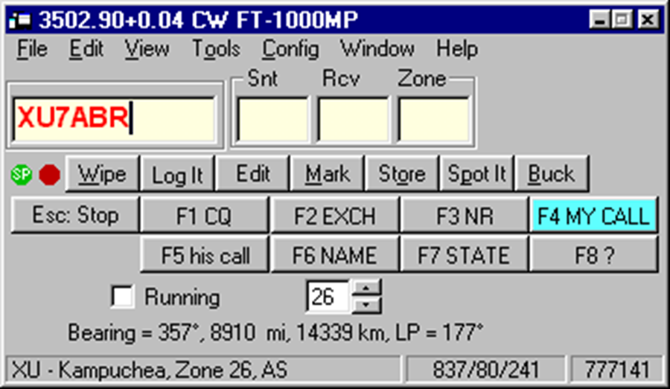
Contests and DXing

Slide 17
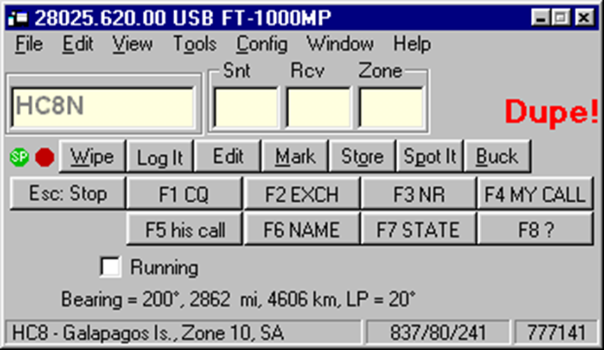
Contests and DXing

Slide 18
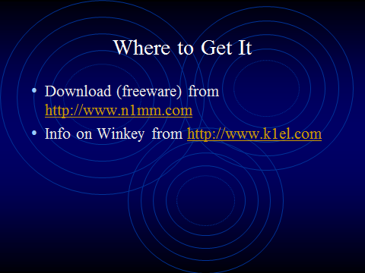
Contests and DXing

Slide 19
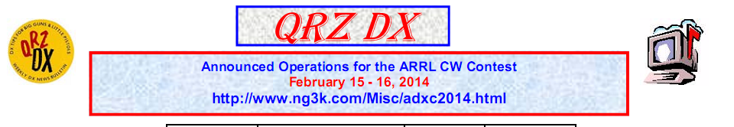
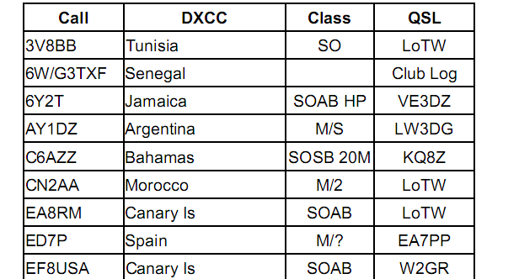
Contests and DXing

Slide 20
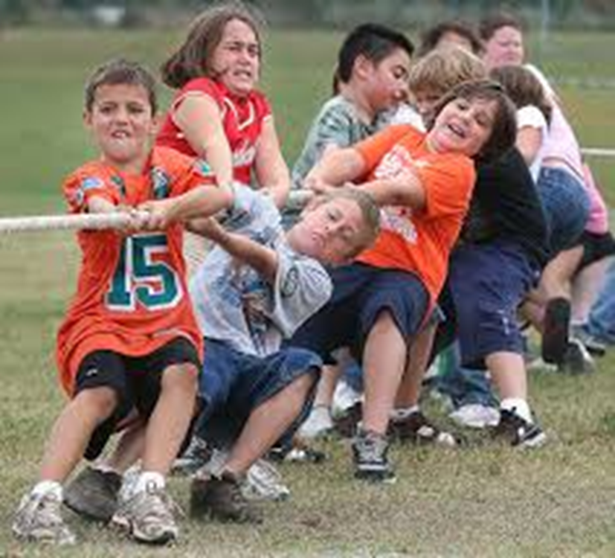
Awards, Contests and DXing
Competition =➔ Improved Skills

Slide 21

Awards, Contests and DXing
Where will you find your next log entry?

Slide 22

Awards, Contests and DXing
Wrap-Up

