Slide 1
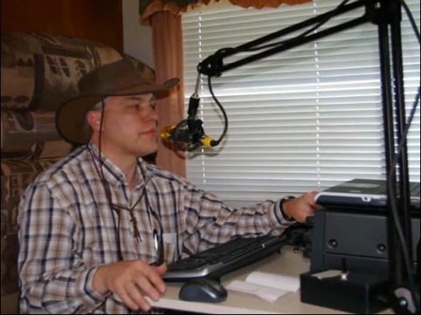
Jed W. Petrovich, AD7KG
Log Data: Integrity and Preservation

Slide 2
Jed W. Petrovich, AD7KG
First licensed October 2005 and earned both General and Extra Class licenses in October of 2006.
Awards: DXCC, 5B DXCC, WAZ, UDXA DXer of the Year, 2011, 2014
UDXA Leadership: President 2009, 2010. Past President 2011. Vice President 2013. Field Day Chair 2008, 2009, 2013, 2014, 2015, 2016.
Portable operating activities: UDXA Field Day 2006 to 2015. 7th Area QSO Party 2007 to 2015. NPOTA 2016.
ARRL Field Day 2006

Slide 3
Data Integrity – Definition
Data integrity refers to the overall completeness, accuracy and consistency of data. This can be indicated by the absence of alteration between two instances or between two updates of a data record, meaning data is intact and unchanged.

Slide 4
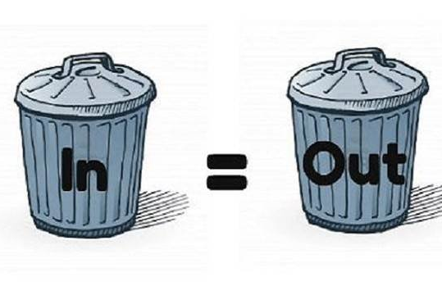
Data Integrity – Definition

Slide 5
Data Integrity – Electrical Power
Electrical Wiring
Overloading Circuits
Surge Protection
Battery Backup (UPS)

Slide 6
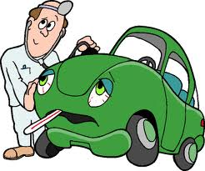
Data Integrity – Computer Hardware

Slide 7
Data Integrity – Consider the Source
Logging Programs
Data Entry
  Accuracy
Importing Log Data

Slide 8
Data Integrity – Tools
LoTW
Club Log
Notes:
Use these programs to help validate data. DXCC entities, Counties, Grid Squares, etc.

Slide 9
Data Preservation – A Case for Paper
What About Paper Logs?
Duplicate Copy?
Disasters
Paper Quality (Acid Free)
Storage

Slide 10
Data Preservation – Electronic Logs
Computers Fail
Mechanical Hard Drives
Solid State Drives
Disaster Recovery Plan

Slide 11
Data Preservation – Local Backups
  External Disks
  Flash Cards/Memory Sticks
  CD/DVD
    Ink Issues
    Archive Quality
    Future Hardware

Slide 12
Data Preservation – Cloud Storage
    Google
    OneDrive
    iCloud
    Dropbox
      History
    “Live” Cloud storage not recommended

Slide 13
Data Preservation – Cloud Storage (cont)
    LoTW
    Club Log
    Other online logs

Slide 14
Data Preservation – Disk Imaging/Cloning
    Macrium Reflect
      Free/Paid
      Incremental
    Clonezilla
      Open Source
    Storing Image Files

Slide 15
Data Preservation – Online Backup
    Remote Storage Advantages
    Mozy
    Carbonite
    Other Services
Notes:
Saxton story.

Slide 16
Data Preservation – Summary
    Questions?

Slide 17


