Slide 1

DX University
Bryce Canyon, UT – 2012

Slide 2
Finding DX Using
Internet and Software Resources
Jed W. Petrovich, AD7KG

Slide 3
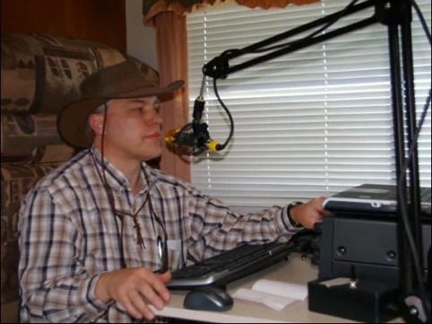
Jed W. Petrovich, AD7KG
First licensed October 2005 and earned both General and Extra Class licenses in October of 2006.
DXCC 262/222 and WAZ. UDXA Field Day organizer 2006 to 2012. 1st Place WPX Phone, Single Op, Low Power, 7th Call Area, 2007 and 2008. 7QP, 2007 to 2012.
Member UDXA, UARC, Polar Bear QRP.
Information Technology field specializing in client applications, databases and data extraction. Author of a commercial software program.

Slide 4

Where’s the DX?

Slide 5
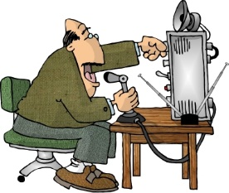
Tuning Around

Slide 6
Looking Ahead - Newsletters
425 DX News
  http://www.425dxn.org/
Weekly DX
Daily DX
  http://www.dailydx.com/
DX Coffee
  http://www.dxcoffee.com/eng/

Slide 7
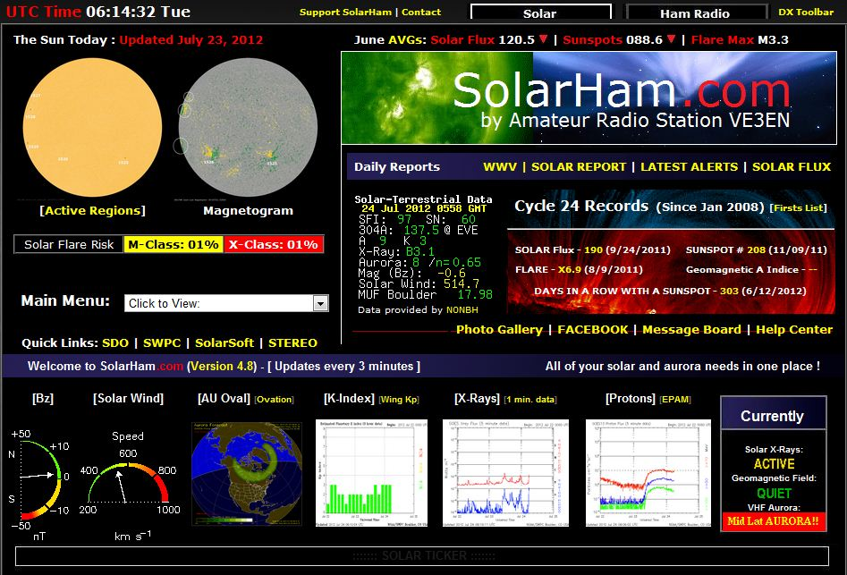
Propagation – Solar Data

Slide 8
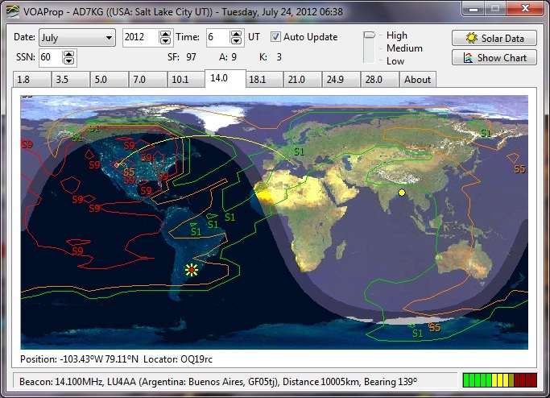
Propagation – VOAProp

Slide 9
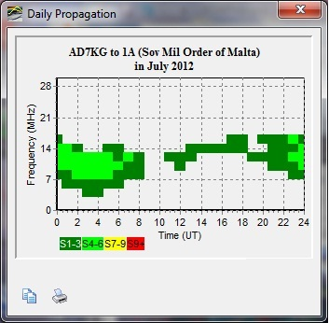
Propagation – VOAProp

Slide 10
DX Clusters
NC7J
  http://www.nc7j.com/
DXSummit
  http://www.dxsummit.fi/DxSpots.aspx
DXWatch
  http://www.dxwatch.com/
Web based, minimal setup required

Slide 11
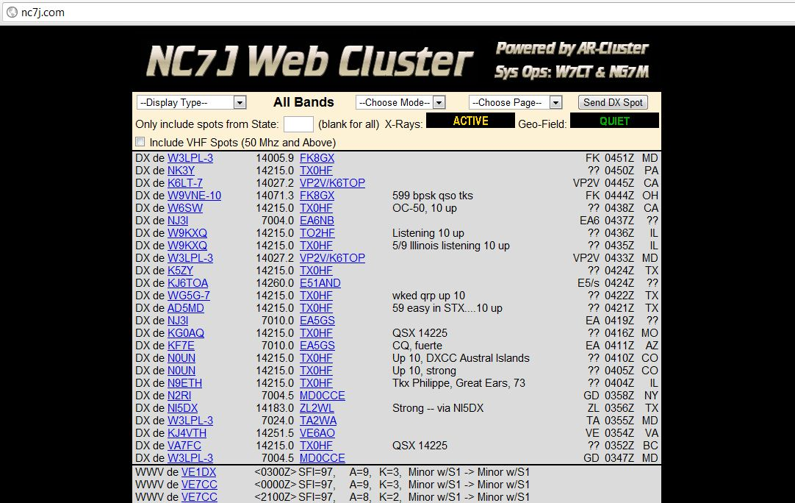
DX Clusters – Example

Slide 12
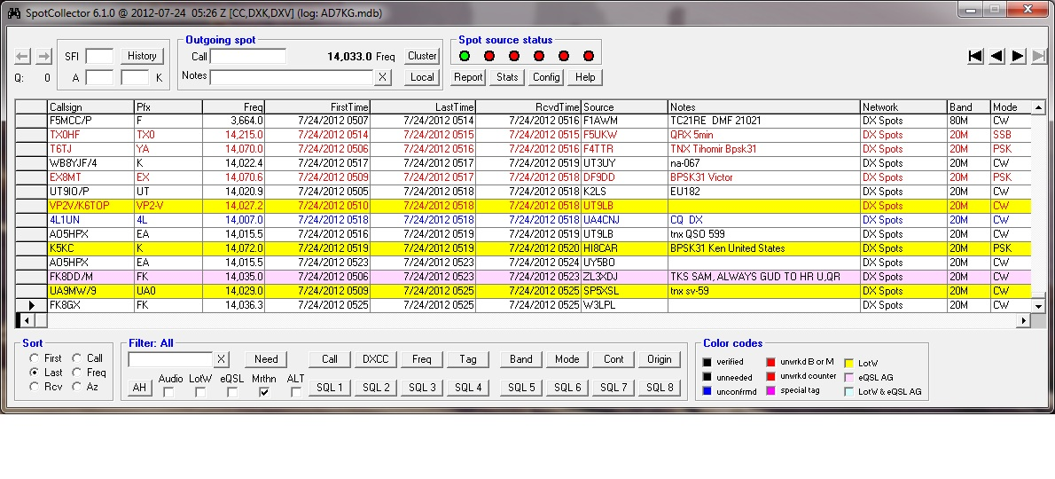
DX Clusters – Logging Software

Slide 13
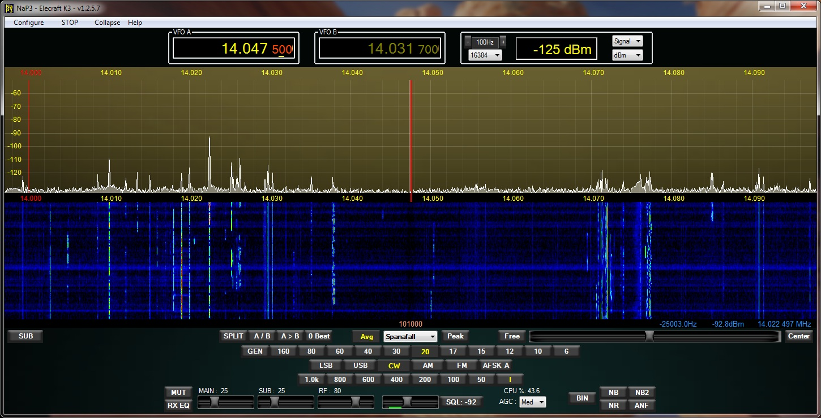
Panadapter

Slide 14
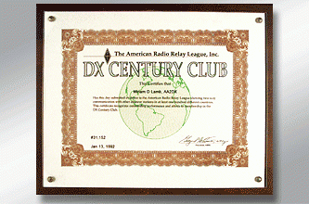
End Result

Slide 15
Questions?
Thank You!

Slide 16
DX University
Bryce Canyon, UT – 2012

