Slide 1

DX University
Visalia California – 2015

Slide 2

Jed W. Petrovich AD7KG

Slide 3
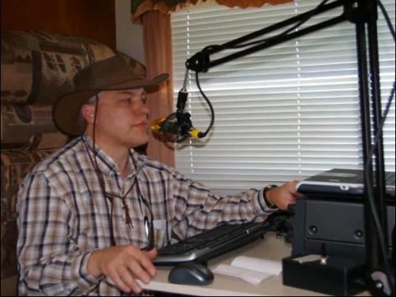
Jed W. Petrovich, AD7KG
First licensed October 2005 and earned both General and Extra Class licenses in October of 2006.
Awards: DXCC, 5B DXCC, WAZ, UDXA DXer of the Year, 2011, 2014
UDXA Leadership: President 2009, 2010. Past President 2011. Vice President 2013. Field Day Chair 2008, 2009, 2013, 2014, 2015.
Portable operating activities: UDXA Field Day 2006 to 2014. 7th Area QSO Party 2007 to 2014.
ARRL Field Day 2006

Slide 4
Why Club Log?
Brief History
Personal use
Exceptions database
Expedition tools

Slide 5
Why Use Club Log?
Most Wanted
Propagation Wizard
Most Wanted
Expedition Charts
Online Log
OQRS

Slide 6
Expedition Criteria
Over 5,000 QSOs
Multi-operator team
Multi-band, multi-mode, working all call areas

Slide 7
Expedition Criteria (continued)
Single callsign
Duration from 1 to 60 days
Request prior to activation
  Email Michael G7VJR

Slide 8
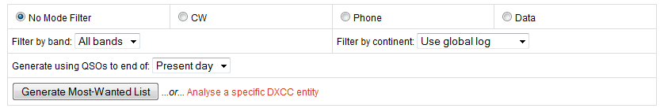
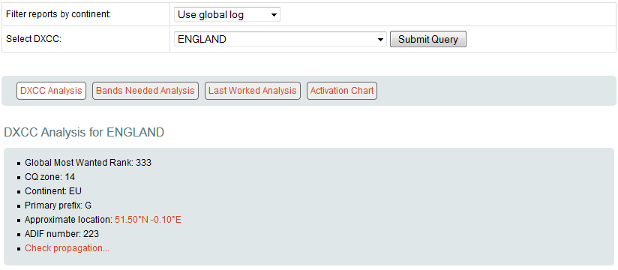
Most Wanted

Slide 9
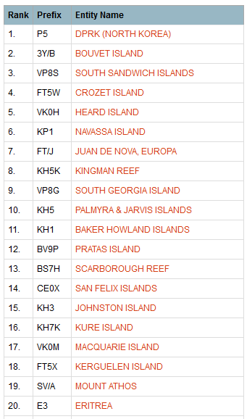
Most Wanted

Slide 10
Propagation Tools
Propagation Wizard
  VOACAP
  Historical expedition charts
  Main charts
Geographic Propagation Wizard

Slide 11
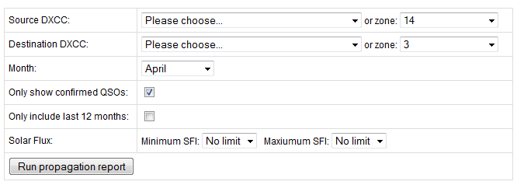
Propagation Wizard

Slide 12
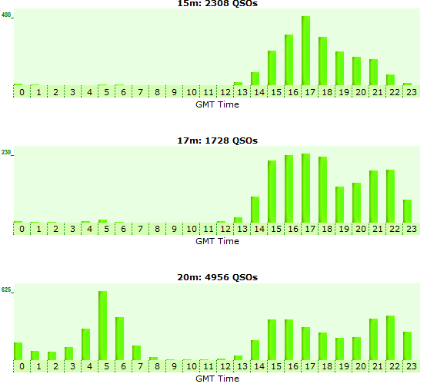
Propagation Wizard

Slide 13
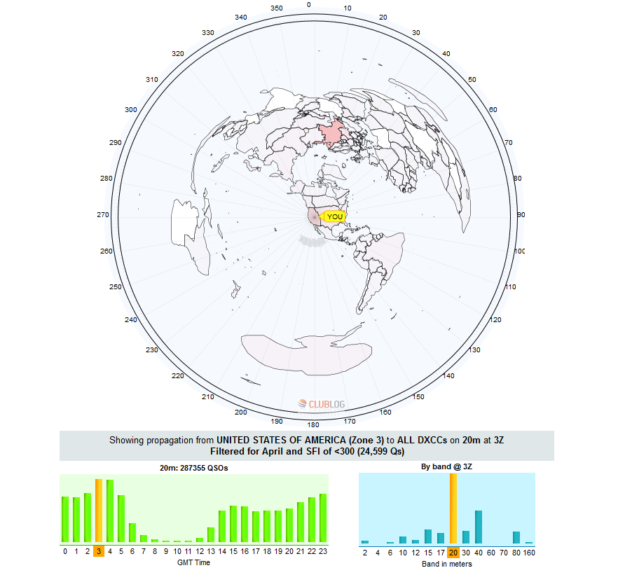
Geographic Propagation Wizard

Slide 14
Uploading Logs
ADIF
  Fields used list
Zip compression
  Reduces file size
Upload queue history

Slide 15
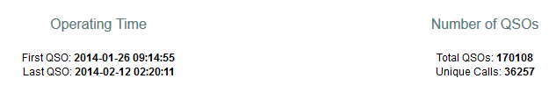
Expedition Charts
FT5ZM

Slide 16
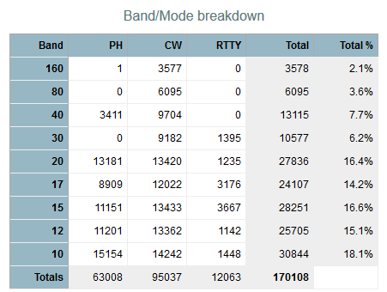
Expedition Charts

Slide 17
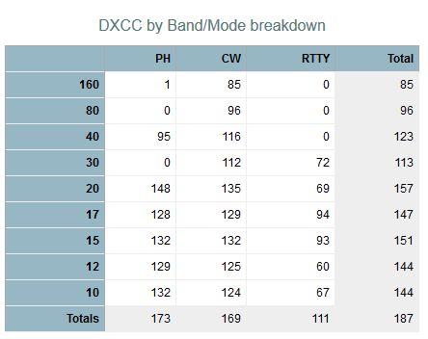
Expedition Charts

Slide 18
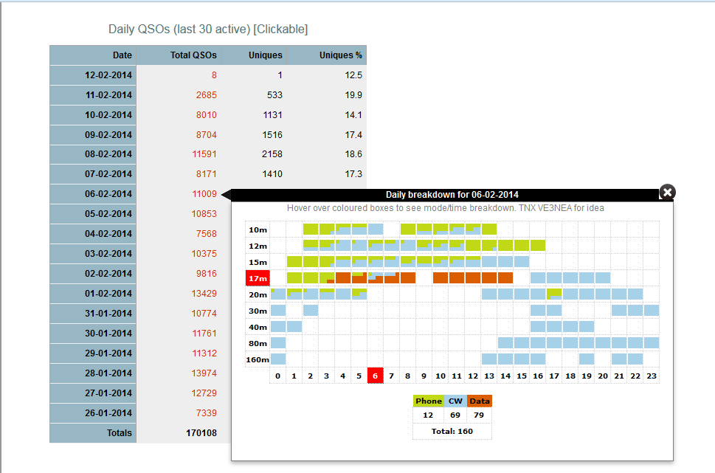
Expedition Charts

Slide 19
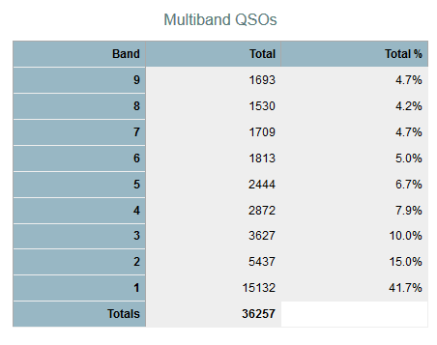
Expedition Charts

Slide 20
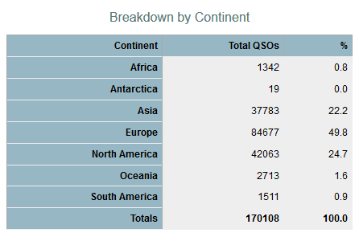
Expedition Charts

Slide 21
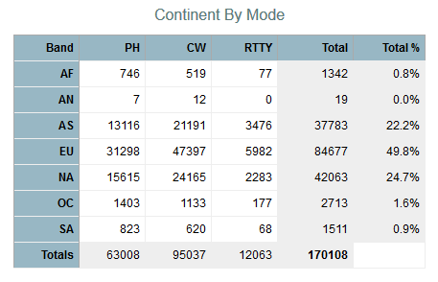
Expedition Charts

Slide 22
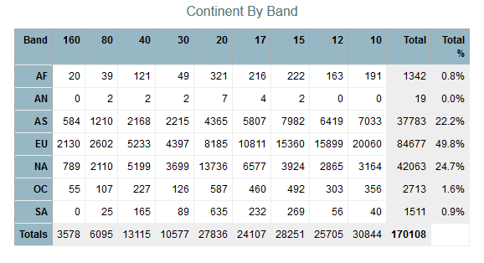
Expedition Charts

Slide 23
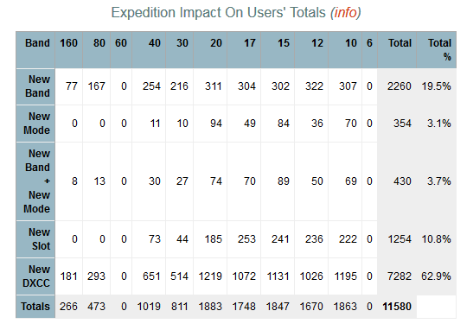
Expedition Charts

Slide 24
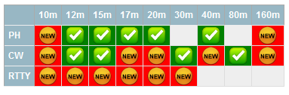
Online Log
Advantages
Reduces “insurance” QSOs
Disadvantages?

Slide 25
Online QSO Requests (OQRS)
Enable OQRS
PayPal - Currency
Pricing
  Direct/Bureau
  Top 30 - $1 flat fee bureau cards
    Reasonable???

Slide 26
Leaderboard
Optional
Pros/Cons
Post-Expedition

Slide 27
Q & A
Jed W. Petrovich AD7KG

